Slide 1
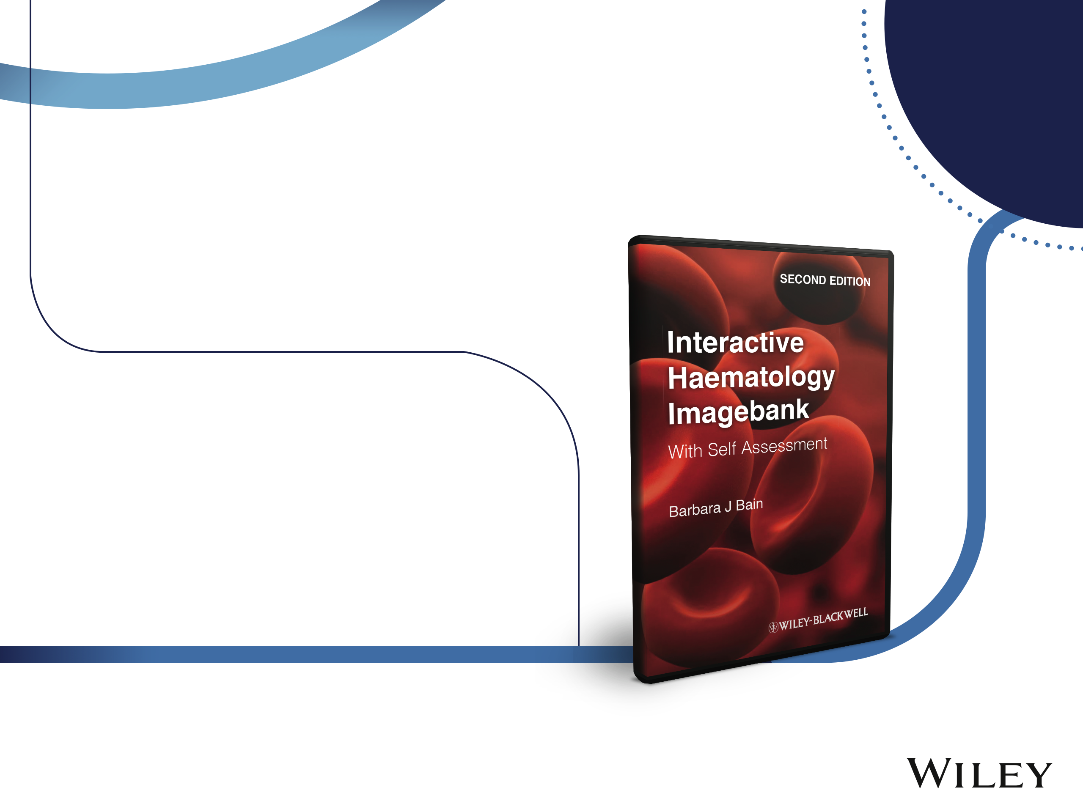
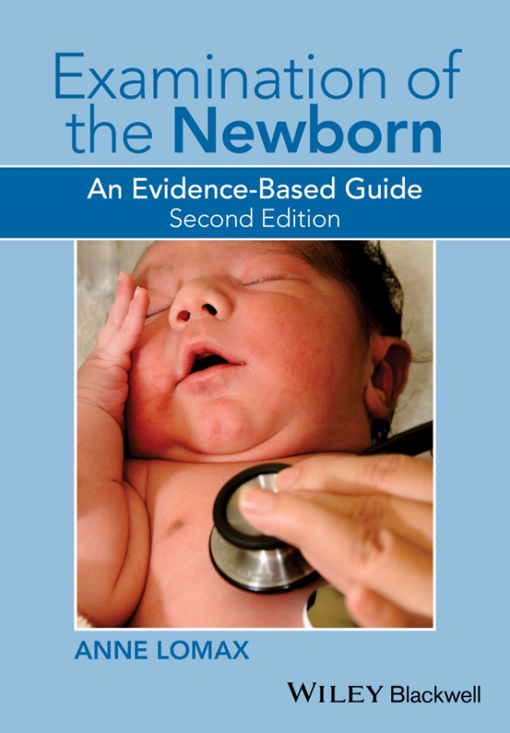
2nd Edition
Examination of the Newborn:
An Evidence-Based Guide
Publishing August 2015
Anne Lomax
A practical and comprehensive guide for students and practitioners to undertake physical examination of neonates safely and competently. Revised and updated throughout in line with current national and Nursing and Midwifery Council guidelines, the text has full colour photographs and illustrations, as well as clinical case studies at the end of each chapter to help guide and illustrate good practice. There is also a website to accompany the book.
www.wileynursing.com

