Slide 1


Process and partnership: factors of success for sustainable visitor transport projects in protected areas
Jo Guiver, UCLan, JWGuiver@uclan.ac.uk
Davina Stanford, Leeds Beckett University, d.j.stanford@leedsbeckett.ac.uk
Notes:
Hello, my name is Jo Guiver and together with Davina Stanford from Leeds Beckett University I am here to talk about our research into two successful local sustainable transport fund projects dealing with leisure travel in rural areas.

Slide 2
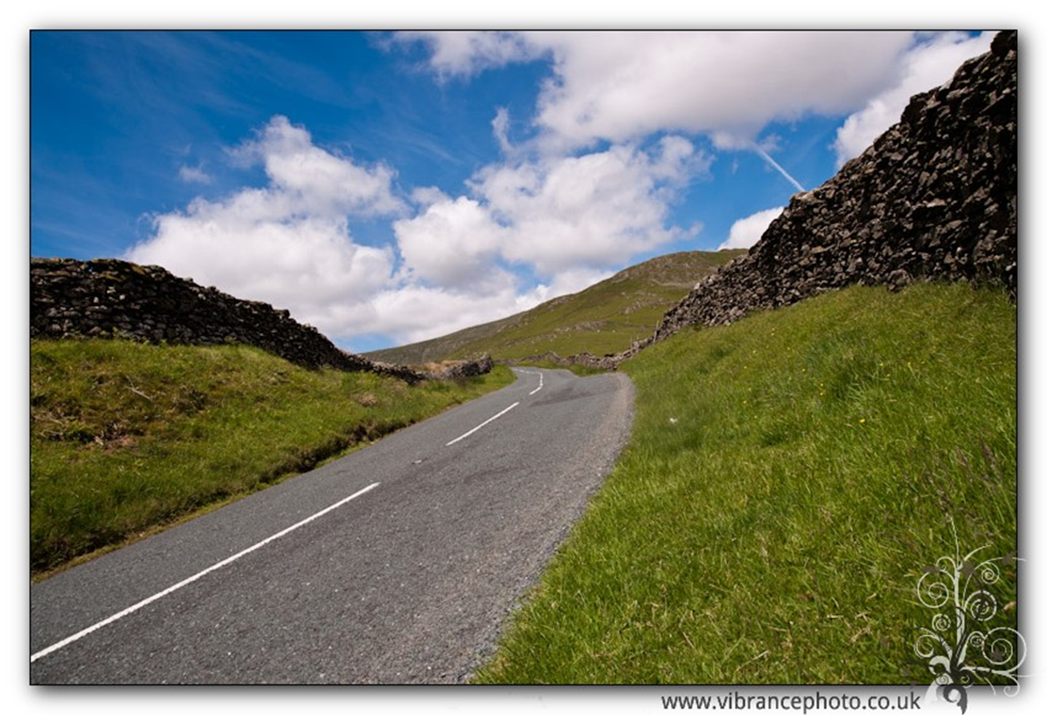
Overview
Issues of visitor travel planning
The benefits of visitor travel planning
The process – partnership working
Methods
Findings

Slide 3
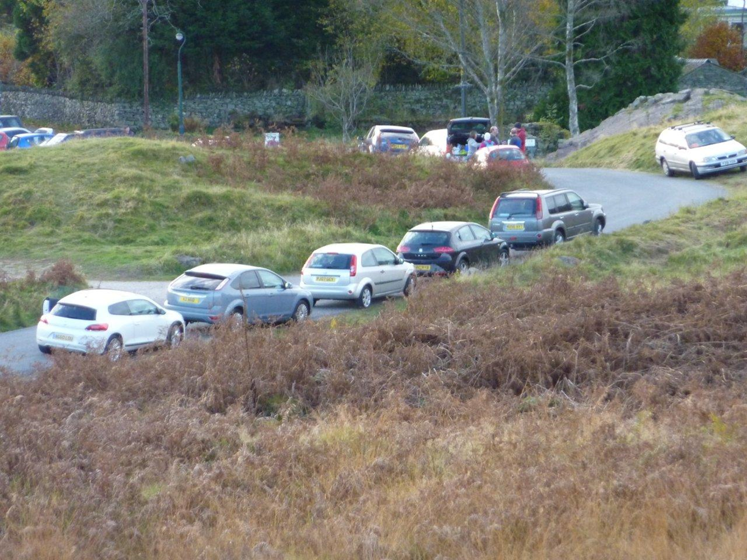
What’s the problem?
In the UK 90% of visits to National Parks are undertaken by private car
(Dickinson and Dickinson 2008, Kendal et al. 2011)
Notes:
So what’s the problem? Basically the car

Slide 4
What’s the problem?
Car traffic destroys the qualities people look for in rural recreation:
Sights
Smells
Sounds
Land
Time
Tourism transport is one of the biggest impacts on local communities
    (Jurowski, Uysal et al 1997; Lindberg and Johnson 1997).
It is also one of the largest sources of tourism’s greenhouse gases
Notes:
Explain each one and how it relates to the visitor experience

Slide 5
But leisure travel is different from utility travel in many ways
Within the destination
Often part of the tourism experience
  Good
  Bad
Destinations are often more flexible than modes
Possibly interchangeable bundles (mode, destination and activity)
Travel within the destination can affect choice of mode to the destination

Slide 6
Destination travel and local economy
Is it
or
Reduce traffic
= enhance visitor experience
= more visitors
= grow local economy
Reduce cars
= reduce number of visitors
= reduce local economy
Notes:
Many businesses think it is the first

Slide 7
In a previous study we found
Although travel planning in tourist destinations offers many opportunities to reduce environmental damage and enhance the visitor experience, it rarely happens.
Why?
Multiple Agencies involved and mostly only thng they have in common is that visitor travel is not at the top of their agenda.
Not only needs provision, needs promotion and information
Notes:
Talk about local authorities, accommodation and transport providers, attractions, etc.

Slide 8
But we found some good practice

Slide 9
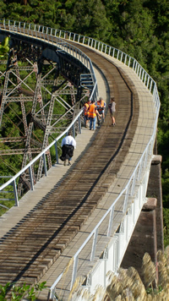
Some good examples
- POSSIBLY REMOVIE SLIDE?
Better visitor-oriented information provides itineraries (see Voies Vertes, France), timetables, location of toilets, gradients for cyclists, degrees of difficulty for walkers (see Ohakune Old Coach Road, New Zealand) estimates of journey times and walker/cyclist friendly accommodation and hostelries.

Slide 10
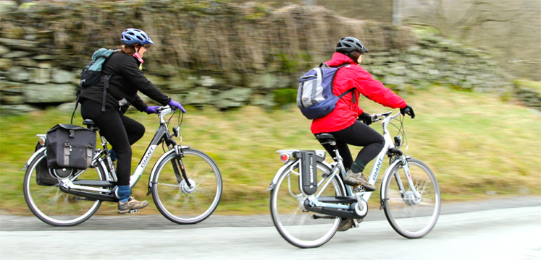
Some good examples
POSSIBLY REMOVE SLIDE?
The use of different media such as apps can provide real-time information and customised interpretation.
Novel ways of travelling such by boat, vintage bus, electric car (New Forest and Brecon Beacons twizzies) or electric bike (English Lake District) enhances fun and excitement.

Slide 11
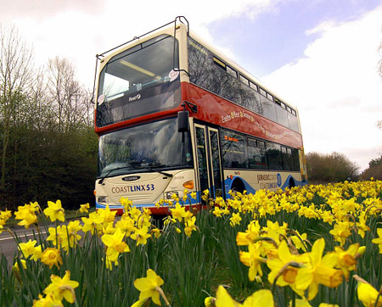
Some good examples
POSSIBLY REMOVE SLIDE
Themed itineraries and interpretation add coherence to routes (for example the Coast and Castles cycle route between Newcastle and Cook’s Lookout Train in Newfoundland, Jurassic Coast bus route in Dorset, UK), better signage, vehicle livery, branded publicity (see Hadrian's Wall AD122 bus and publicity) and staff training all help to improve the visitor experience.

Slide 12
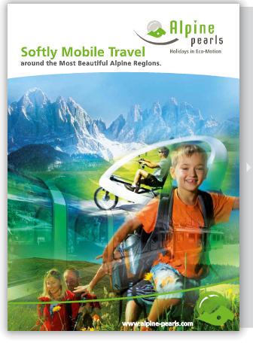
Alpine pearls
The travel offering varies between villages, but includes electric vehicles, shuttle buses, horse-drawn carriages and ski lifts and many of the resorts provide an inclusive ‘guest card’ for free transport and discounts in the area.
Little understood about governance

Slide 13
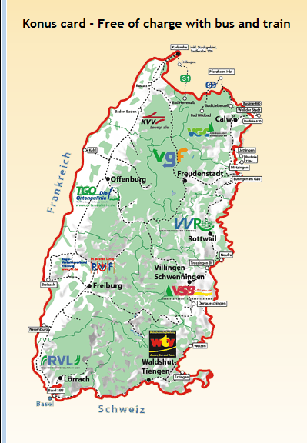
Konus Card,
Black Forest
free use of local public transport
Funded by accommodation tax
No monitoring

Slide 14
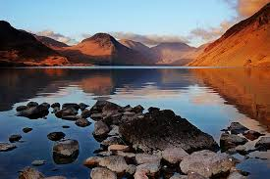
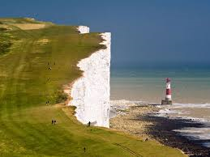
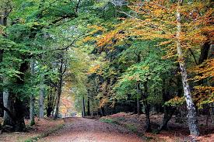

Slide 15
Method
Three case studies
Semi-structured interviews
17 participants, including a mix of representatives from the public (10 respondents), private (5 respondents) and voluntary sectors (2 respondents)
Thematic analysis.

Slide 16
 | Lake District | New Forest | South Downs
Location | North England | South England | South England
Area | 2,292km2 | 300 km2 | 1,600km2
Established as National Park | 1951 | 2005 | 2009
Residents | 40,800 | 34,500 | 107,000
Visitor days | 15 million | 13.5 million | 39 million
Visitor contribution to economy | £2.2 billion | £123 million | £333 million
Jobs created by tourism | 15,244 | 2,451 | 5,000
% visitors arriving by motorised vehicle | 85% | 85% | 80%

Slide 17
Getting started
The Park authority have a culture of just go and get on with it, if it’s a good idea…. I would argue that giving money to non-transport organisations to do transport solutions is a highly cost effective way of getting stuff done because transport authorities are large, cumbersome authorities that take a 1000 years to decide to do anything. Whereas we just think, let’s get on with it… We’re solutions focussed…. People recognised that in order for it to work it couldn’t be designed by committee. The CEO was brave to allow me to do this. [3]
They had a difficult time with that [the delivery] because they hadn’t really sorted out the governance before they submitted the bid. Cumbria County Council was the accountable body and once they got the money they talked about how it was going to be delivered and they hadn’t really bottomed that out before. [5]

Slide 18
Public / private sector roles
One of the beauties of our involvement is that we are largely free of bureaucracy that the County Council and the National Parks have and that allows us to respond quickly. [2]
The real world is quite messy and complicated and what we like to do is create frameworks for working so that it makes the real world a bit less complicated, so that other people have a clearer understanding of what our shared priorities or aligned priorities are. [3]

Slide 19
The emphasis on visitors
…there is a resident population of 40,000 and 16 million visitors a year, so if you really want to achieve some significant carbon reduction in terms of travel behaviour you need to work on visitors…
We always went into it that it would be easier to influence visitor travel behaviour than residents. They have more time and are more amenable.
Open to new experiences perhaps…. There is also the link between a behaviour change on holiday and carrying on with that behaviour at home. [1]

Slide 20
The emphasis on visitors
If we are going to create world-class visitor experiences with prosperous economies which drive sustainable communities then sustainable tourism has to be central to that, to the world-class visitor experience. Being stuck in a traffic jam is not a world-class experience. so it is key to improve the sustainable transport alternative…if you can make the journey part of the day out then people will use it…. And if you give people a world class visitor experience they will pay a commercial rate for that and therefore you can sustain that. [9]

Slide 21
The emphasis on visitors
The private sector see transport as a secondary thing. They see the visitor experience as the most important thing. It’s difficult to engage them by saying how important sustainable visitor transport is, but they are interested in the visitor experience. [2]

Slide 22
The emphasis on visitors
The county council pay lip service to visitor transport, they are much more interested in moving residents and the business community around and frankly they are not that bothered about the visitor because they don’t vote. They have no statutory requirement and they tend to back off. If you look at their objectives outside of the LSTF bid, it’s about ease of access to work or schools or doctors and shops. But if they really want to make some bite sized chunks into carbon reduction, congestion, air quality, then they should be going for the visitor. [2]

Slide 23
Community resistance
Some community groups have complained … but when we speak to them they realise there is a benefit. It’s more a perception than a reality….Communicating with the local community was not built into the project, and that perhaps was a weakness particularly at the beginning as there wasn’t any lead time. The announcement came, the money was available, and … that turned very quickly into we need to deliver and spend the money. I think we missed an opportunity to engage local residents after the bid announcement had been made. [5

Slide 24
Communication
To visitors:
We need to market behaviour change to visitors or we can’t change anything. So marketing is crucial and it was a big part of the bid. [10]
With businesses:
We [public sector] need to be a bit less lazy and talk more business speak, frame whole propositions, questions and problems in the language, context and ethos of the private sector because if the private sector don’t want to pick it up we just end up pouring public money down a hole. [3]
The Local Economic Partnerships in order to gain their support:
The LEPS are all about economic growth. Our focus is on sustainable tourism and we need to attract new types of visitor – ones who have economic contribution but not arriving by car and the offer has to appeal to them. If you can make the economic case then the LEPs are supportive. [13]
And with residents :
…if anything does look like it is presenting a change it has to be carefully communicated. We stated that this would enable people to make a choice and that it would make sustainable transport easier and that residents could use that too. [10]

Slide 25
Governance / government
It’s best to leave local politics out of it and we try not to involve local councillors… we try to get on with things… you should not have councillors running schemes as they become political and we want to get on without interference.[15]
… the political environment wasn't easy. The National Parks has a board which is made up of elected members and nationally appointed… all are meant to operate in the interest of the National Park as a whole but obviously this doesn't happen in reality and some want to fight for funding to be spent in their particular area. I remember examples of x being called up directly by members asking what was happening in their constituency, she spent much time on the phone talking to members about this, thus allowing the political culture to develop where members got involved in real hands on decisions instead of taking the strategic decisions.

Slide 26
Sort-termism
Funding should not be time-limited. It takes longer than three years and then it ends up being not about what needs to be done, about what money is available and what can be done in that time. [15]

Slide 27
Enablers
Barriers
Expertise
Enabled individuals
Personal passion
Strong governance
Partnership working – collective vision, synergy
A positive visitor experience
Communication
The political agenda
The private sector
The National Park
Partnership working – slow!
Bureaucracy
Lack of interest from councillors
Opposition from residents
Communication
The political agenda
Short term nature of the funding
The private sector (the economic imperative)
LEPs

Slide 28
The most significant?
The single most important factor of success? The communication. The projects are great, but if they happen alone, then it’s not good enough.
Visitor experience

Slide 29
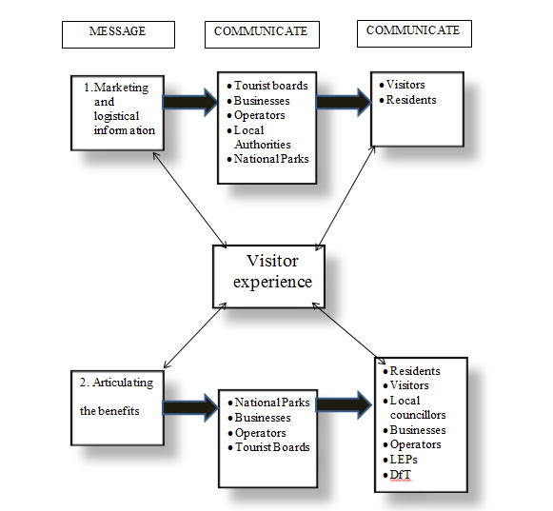

Slide 30
Project stage | Desired Communication
Bid Preparation | Bid written ‘in the language’ of funder (Department for Transport) Getting support from local politicians Explaining importance to local stakeholders asking them for letters of support If possible set up procedures for governance.
Set up Phase | Explain benefits to stakeholders, particularly those not involved in pre-bid discussions, e.g. local residents. Make sure partners share goals and understand roles. Communicate urgency of getting projects working quickly to make use of project time.
Execution | Put new schemes into action and market them to visitors and residents. Need for factual information in variety of modes. Allay fears of residents. Report of project progress and find compromises as required through governance structures
Closing | Ensure projects are bequeathed to organisations able to continue them, selling them in condition and in terms that will interest new owners, e.g. infrastructure development to LEPs, benefits to community to local groups, commercial benefits to private sector. Debrief project staff as they leave, to ensure continuity of knowledge.
Afterwards | Evaluation from monitoring, Messages to other who want to try to emulate schemes

Slide 31
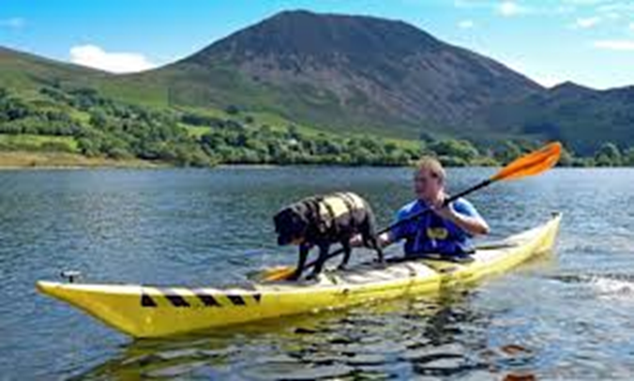
Thank you
Any questions
D.j.stanford@leedsbeckett.ac.uk
Jwguiver@uclan.ac.uk

