Slide 1

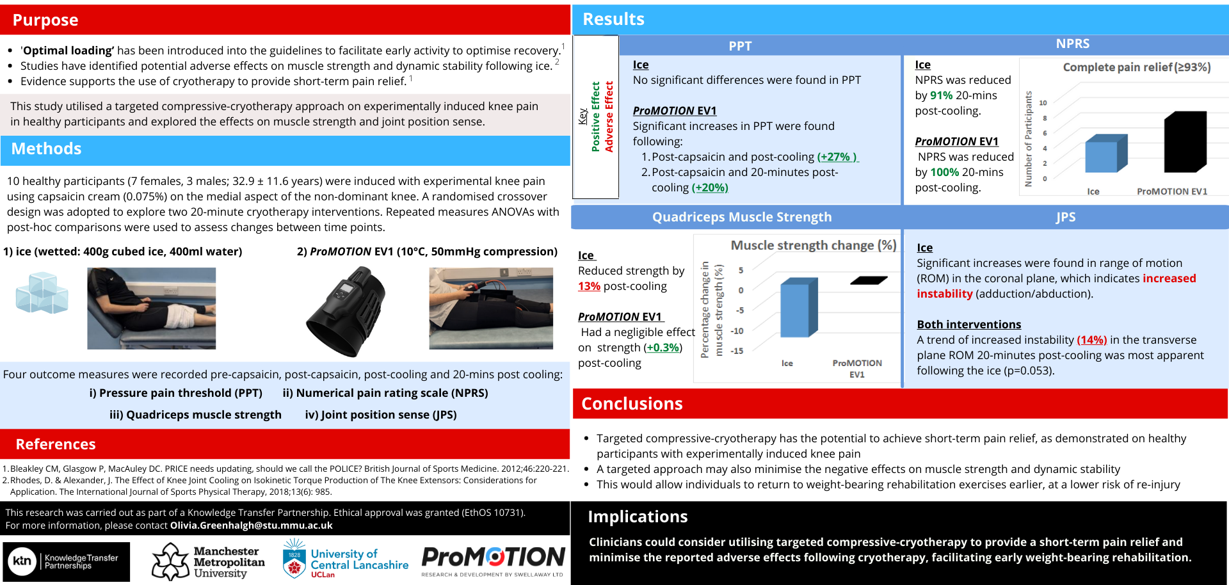
Theme: The Rehab Challenge - Quantitative
Exploring effects of cryotherapy modalities on pain, muscle strength and joint position sense in healthy participants with induced knee pain
O. Greenhalgh¹, J. Selfe¹, J. Richards², J. Alexander², C. McCarthy¹
Manchester Metropolitan University, Department of Health Professions, Manchester, UK
University of Central Lancashire, Allied Health Professions Research Unit, School of Sport and Health Sciences, Preston, UK
Abs.no:
423

