Slide 1

Travel Disruption and what it tells us
Dr Jo Guiver
Institute of Transport and Tourism
University of Central Lancashire, UK
Notes:
Good afternoon, my name is Jo Guiver and I’m a researcher in a very small institute in the North West of England. My topic today is very much work in progress and results from three pieces of research we carried out in the last year and a bit. I would value your reflections.

Slide 2
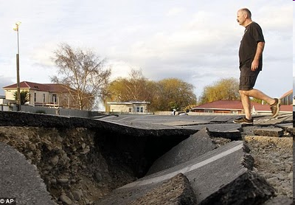
Vulnerability of Transport
Physical
Connects all human activity
Extended, exposed infrastructure and activity
Susceptible to weather, earth, air and water movements and conditions
Notes:
Transport is the movement of people or goods and is necessary for virtually all human activity, be it a walk to the bathroom or a flight to an exotic holiday location. It has an increasingly extended network which is mostly just left out in the open, where it can be exposed to all sorts of climatic, natural and human impacts

Slide 3
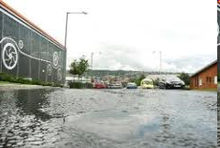
Vulnerability of Transport
Human
Lines and networks cross, link and sever other networks and activities
Relies on human actions to maintain, perform
and respect it
At risk from strikes, negligence, terrorism and its prevention, bad management, etc
Notes:
Not only is it at risk from natural forces, it is easily affected by human activities, such as those it serves, those it damages or just crosses including other transport networks. This is a road that was closed last summer because of water leaking from a canal.
It is vulnerable to deliberate interruption such as strikes, vandalism, terrorism but also human negligence, incompetence, mismanagement, unpreparedness

Slide 4
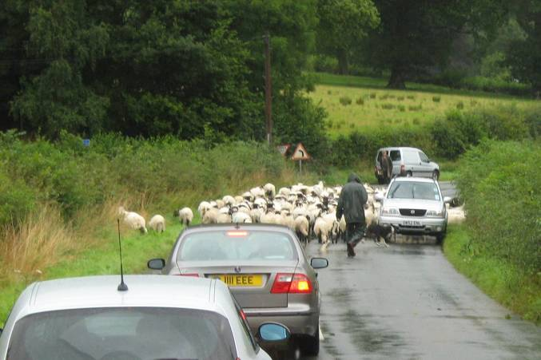

Slide 5
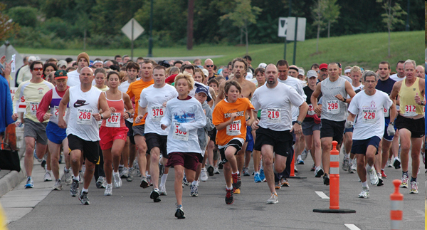

Slide 6
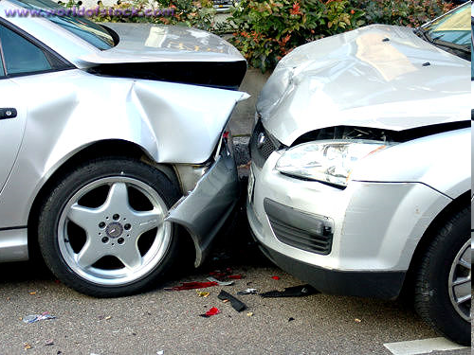

Slide 7
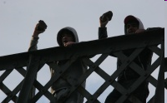

Slide 8
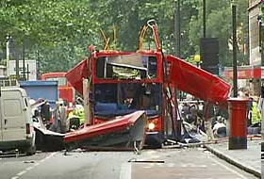

Slide 9
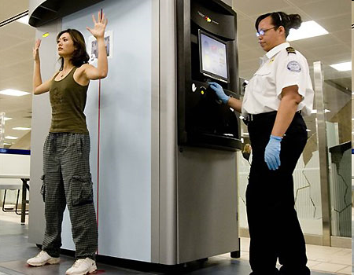

Slide 10
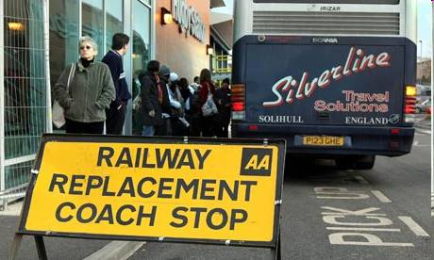
Three Studies
Volcanic Disruption to aviation in April 2010
Destruction of road connections between parts of Workington, Cumbria in 2009-2010
Winter Weather in UK December 2010

Slide 11
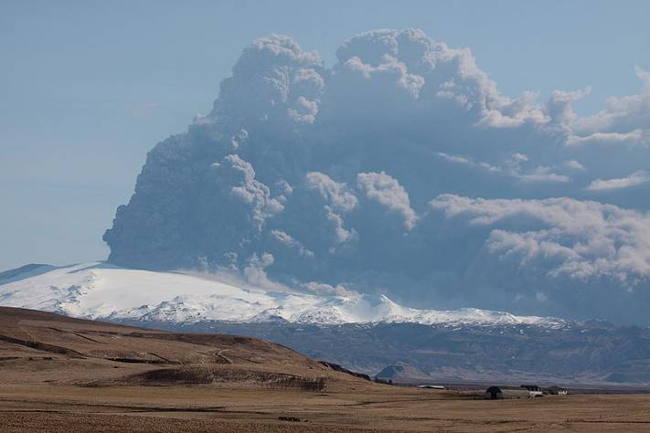
Volcanic Ash
April and May 2010
over 100,000 flights were cancelled during the volcanic ash crisis in April 2010, with over 10 million people affected
On-line survey, 507 respondents,
open and closed questions

Slide 12
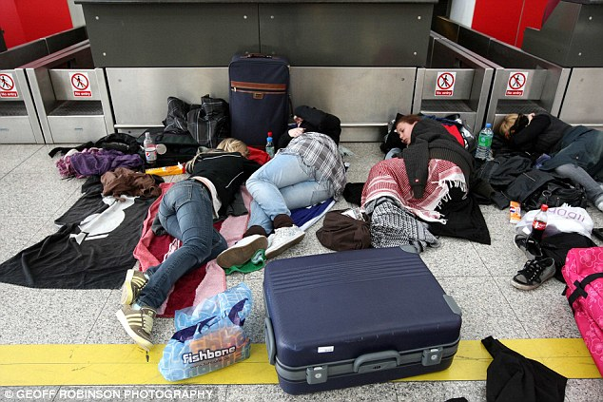
Volcanic Ash: Findings
Importance of technology for information
Uneven access to technology, information and other support
Reliance on family and friends for assistance and standing in for strandee
Distress to others
Lack of insurance and/or cover
Surface travel eroded by cheapness of flying

Slide 13
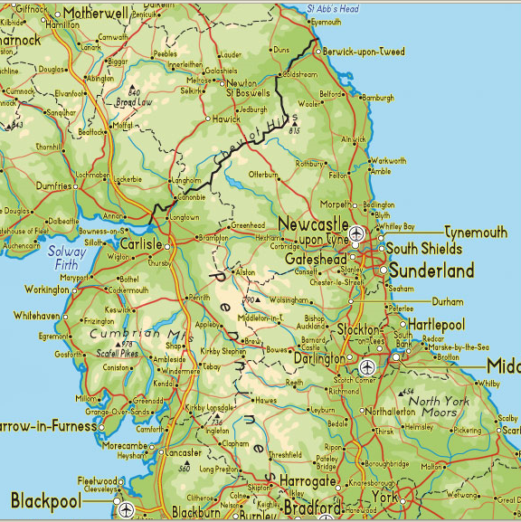
Workington
Workington
© 2003 Map of United Kingdom & Rob Hilken <a href="http://www.map-of-uk.co.uk">Map of UK </a> by Tourizm Maps &copy; 2003

Slide 14
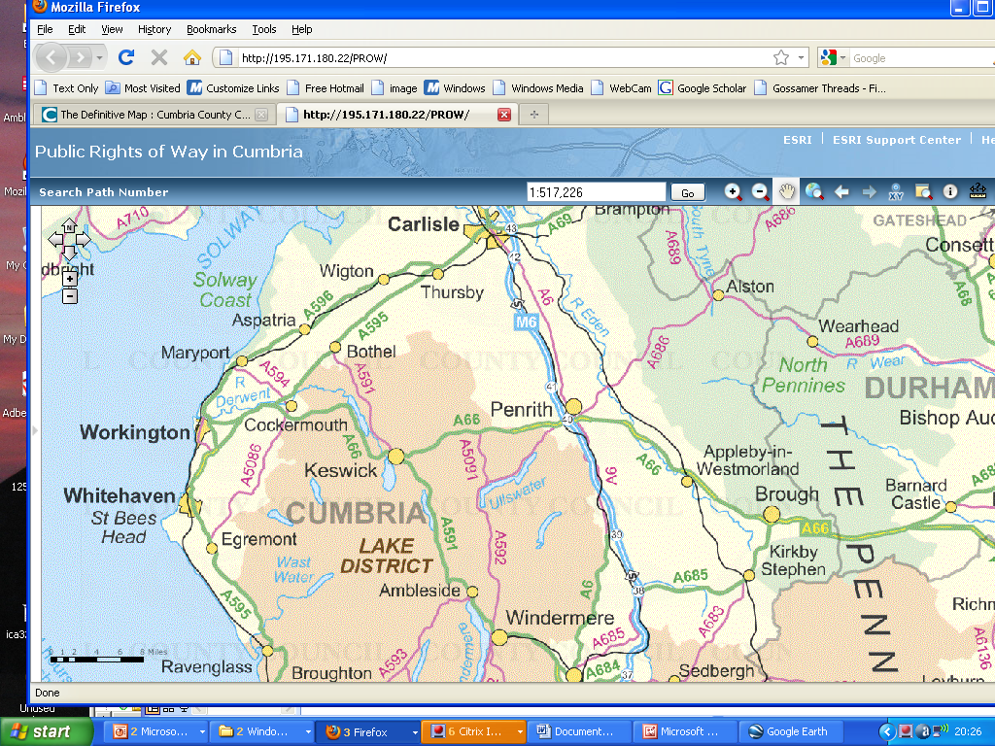
Cumbria
Copyright of Cumbria County Council

Slide 15
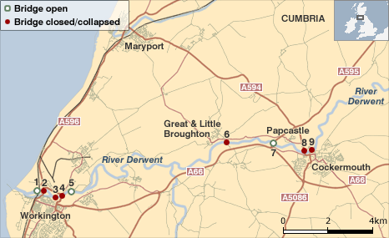
Bridges open and closed around Workington
Reproduced with kind permission of BBC

Slide 16
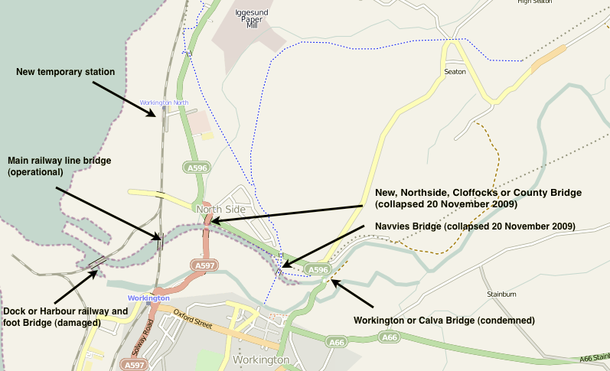
Workington’s Bridges on 21st November 2009
This file is licensed under the Creative Commons Attribution 3.0 Unported license.
Attribution: Andy V Byers at en.wikipedia

Slide 17
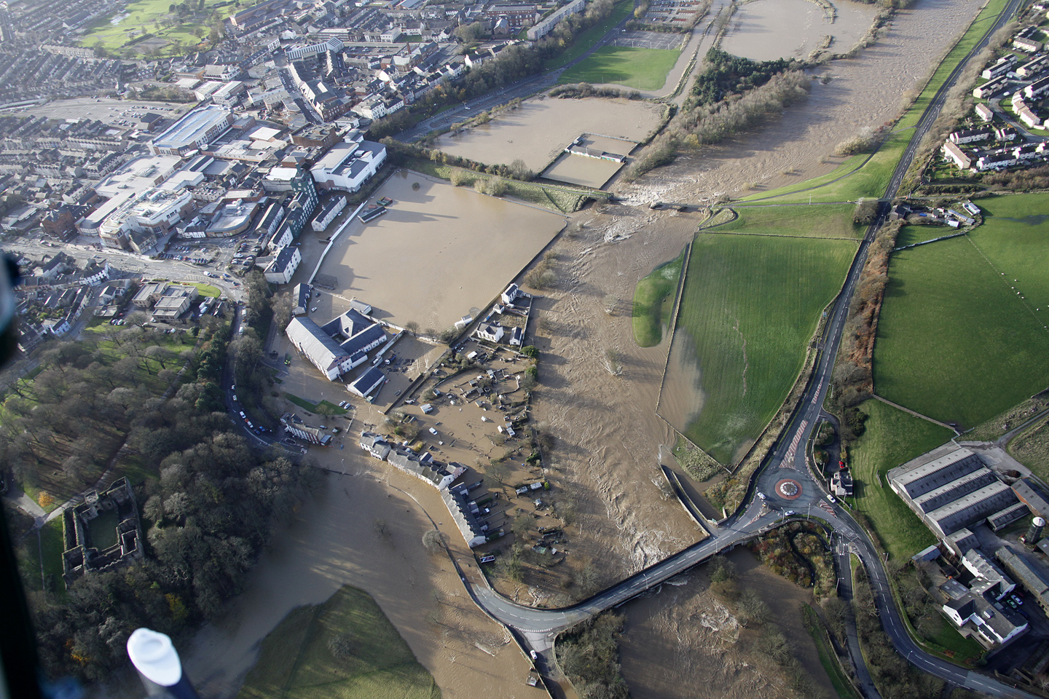

Slide 18
Workington
Road Bridges destroyed or damaged, 18 mile detour
Railway open, new station built in 6 days on north of river
Footbridge erected by army two weeks after floods
5 months when road travel lost advantage of time, convenience and cost

Slide 19
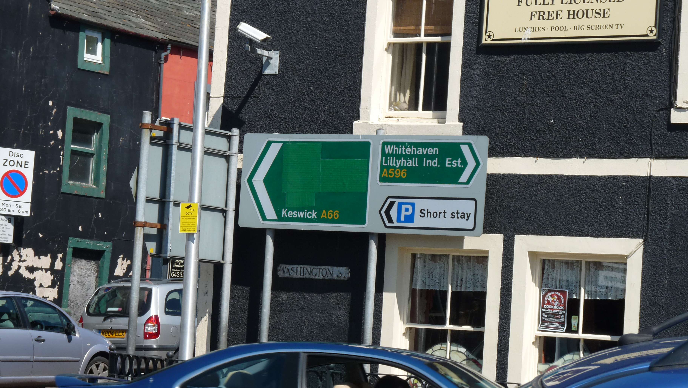

Slide 20
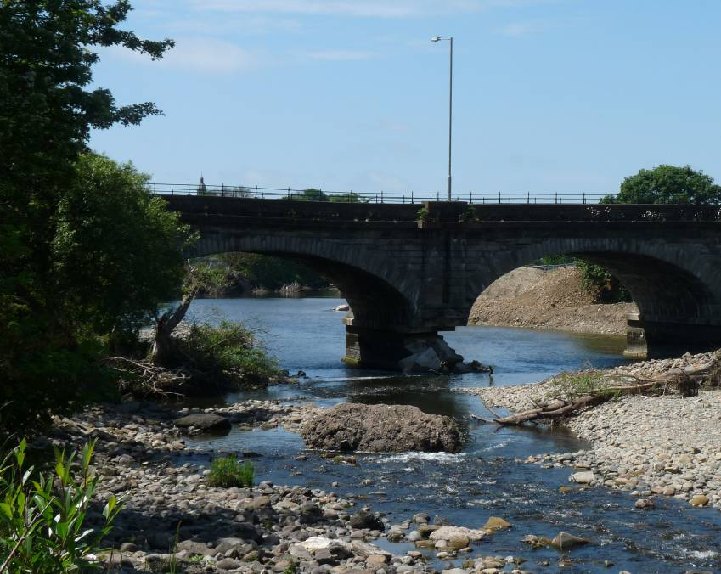
Workington Research
Household Postal Survey + online
Poor response rate
280 responses:
435 people
Interviews with stakeholders and residents

Slide 21
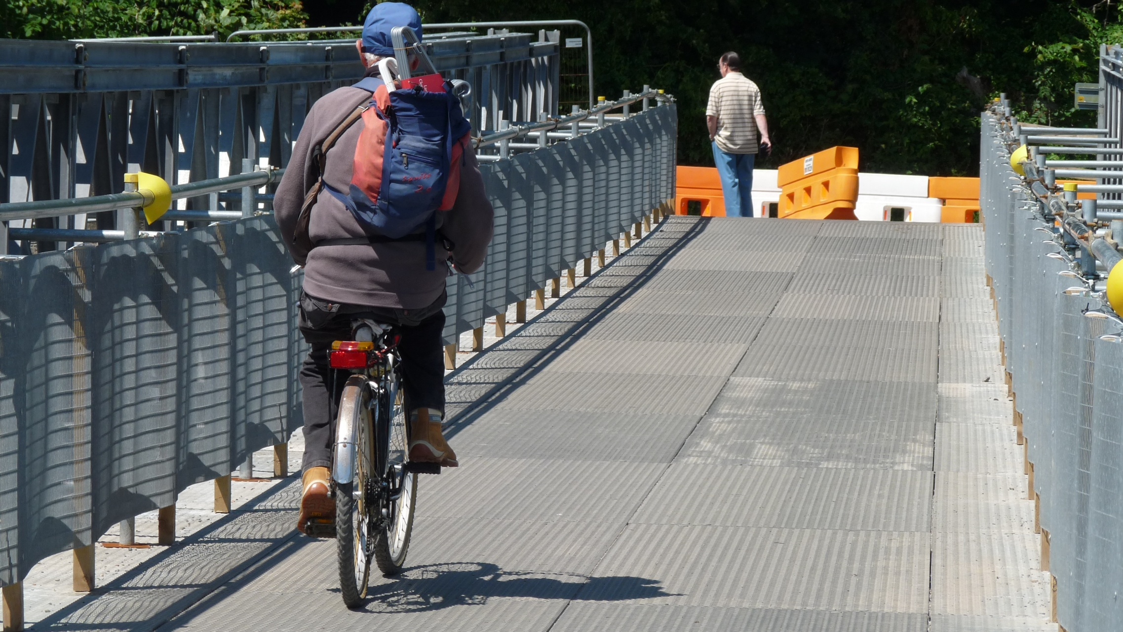
Workington: Findings
Changes in routes, destinations, origin, frequency and mode
Leisure and social trips most affected
Positive benefits to those who tried walking and rail
Real costs and hardships to those who
continued to drive or needed to
Adaptability of employers and other agencies
Effects lasted for some

Slide 22
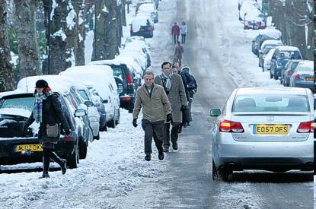
Winter Weather
December 2010, UK
Extreme and early snow and cold
Affected most transport: walking, cycling, roads, rail and flying
On-line survey,
791 reported disrupted journeys
Uneven spread across country
Various modes
Interviews: on going

Slide 23
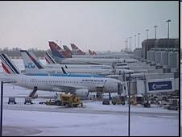
Winter Weather: Findings
Most people agree that pavement clearing is as important as road clearing, climate means more extreme weather more often and the UK is never prepared.
Most people disagree that they would be willing to pay more to be better prepared
Ambivalence whether better preparation would be too expensive

Slide 24
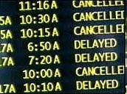
Winter Weather: Findings
Main problem for all modes: extra journey time
Plane travel caused most inconvenience to self and others and distress to self and others

Slide 25
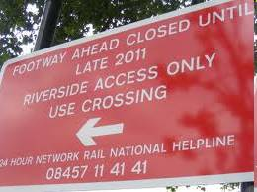
What do they have in common?
Disruption provides a mirror and refelection on normal travel and expectations
Inter-dependences
Families, employment
Time
Space
Activities

Slide 26
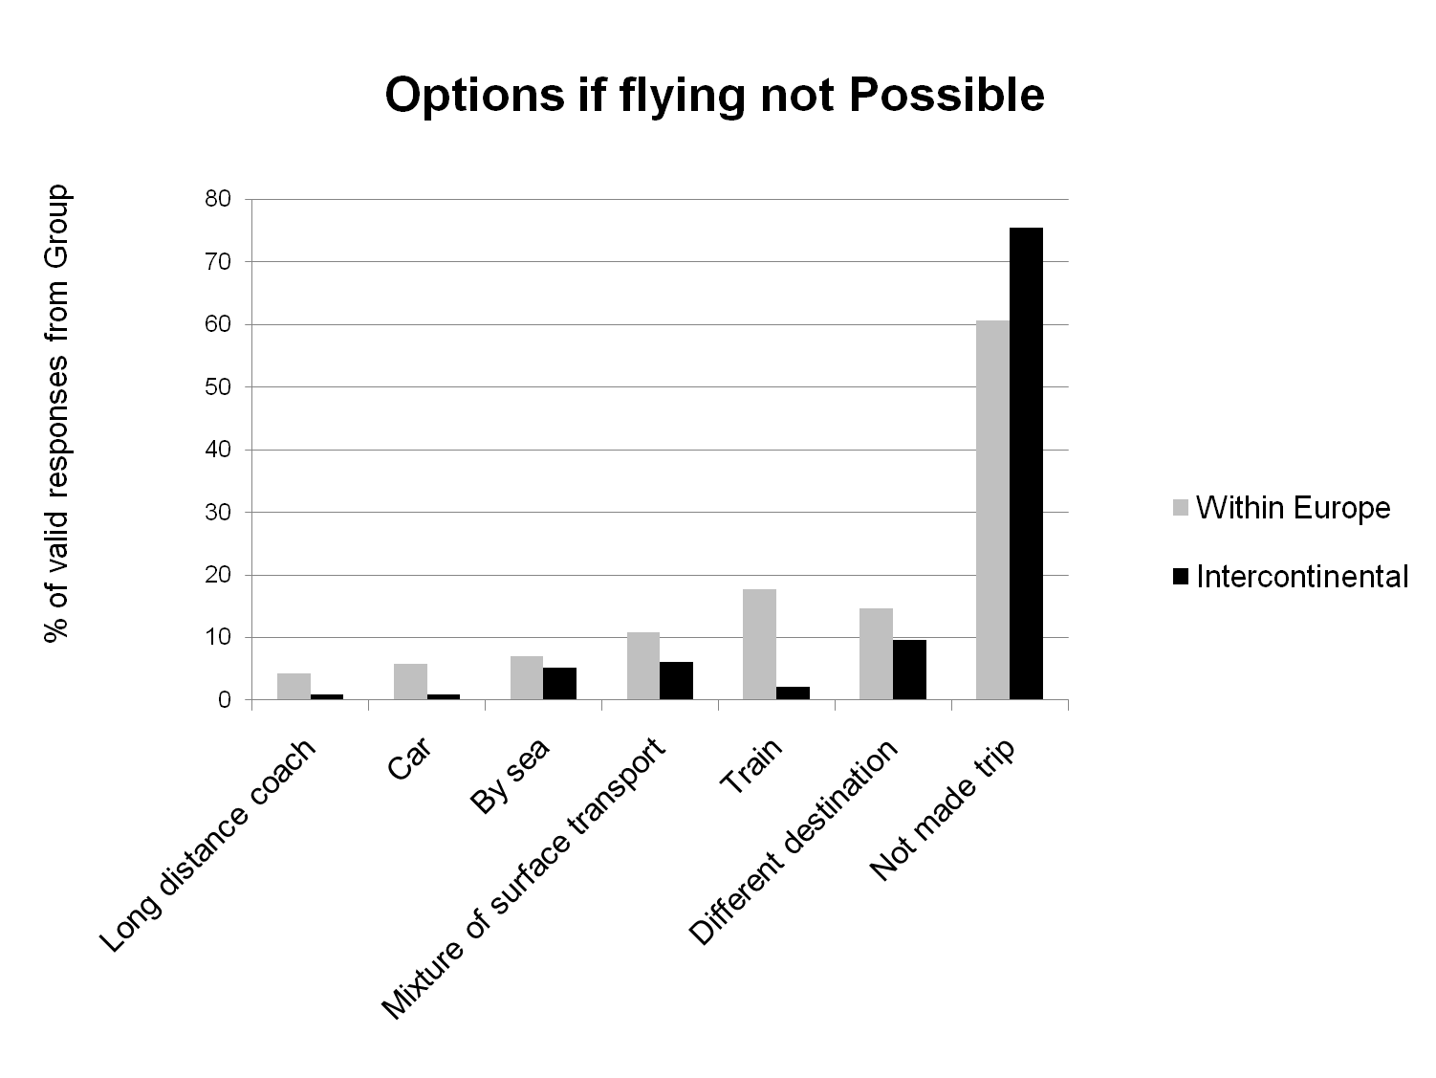

Slide 27
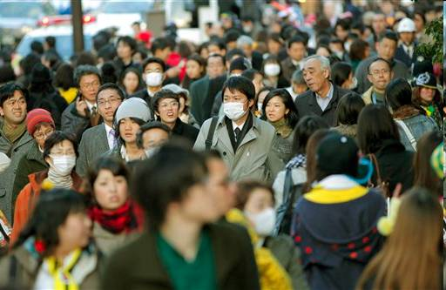
What do they have in common?
Some benefits to travellers and non-travellers
Caused re-evaluation of priorities both during the problem and for future travel

Slide 28
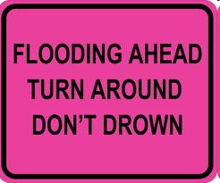
Similarities
Importance given to information
Degrees of resilience
Creative adaptation

Slide 29
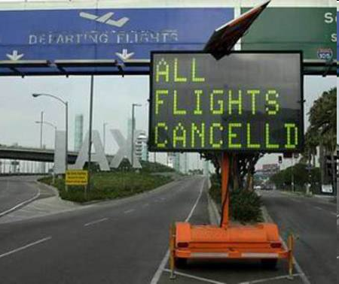
Differences
Scales of both journeys and disruption:
Geographical
Temporal
Causes and blame
Notes:
The winter weather affected all sorts of journey from a walk to the shops to an inter-continental migration, the volcanic ash mostly affected non-routine journeys and the destruction of the bridges in Workington mostly affected daily and weekly routine journeys, but because it was a localised emergency, it was able to mobilise national resources for the station and footbridge.

Slide 31
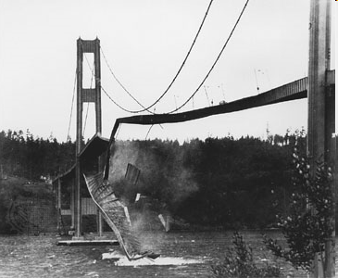

Slide 32
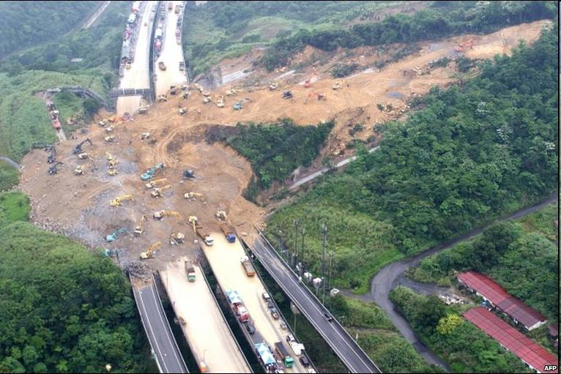

Slide 33
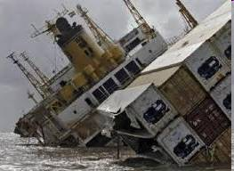

Slide 34
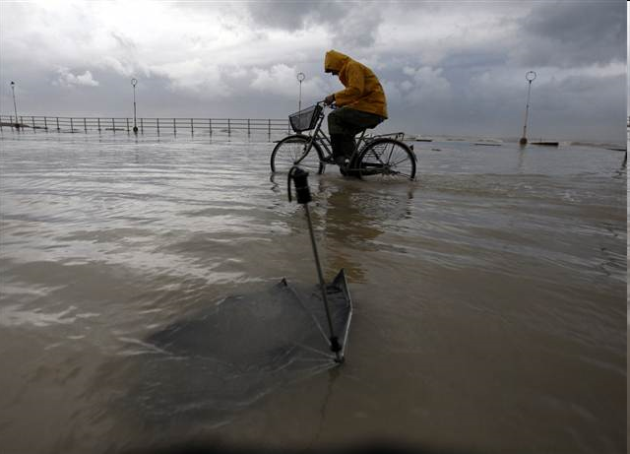

Slide 35
Winter Weather: Findings so Far

Slide 36
