Slide 1
KINDness and Connection through Creativity
Dr Suzanne Wilson (BSc, MSc, MPhil, PhD)
Research Fellow in Social Inclusion and Community Engagement
Deputy Director: Institute for Planetary Resilience and Community Transformation (PACT)
Centre for Community Connectedness and Co-Operation
University of Central Lancashire
Notes:
The geographic, social, and economic context of rural coastal areas can create conditions that leave communities vulnerable to physical, emotional and cultural isolation. This isolation can further exacerbate social exclusion, creating a vicious cycle. Moreover, families, mothers in particular, have been found to have increased vulnerability to loneliness and often feel removed from local supportive services (Wilson & Morris, 2023). The research being shared in this workshop proposes that relational wealth through creativity is a means to overcome loneliness and isolation and foster relationships on multiple levels, promoting social inclusion. Based on the scientific principles behind relational sociology (Crossley, 2012), we will demonstrate how meaningful interactions can promote the participatory dimension of social inclusion (Levitas et al., 2007).
The workshop will provide a background and context to the session, Creative exercises will follow an introduction to relational wealth building, and the session will end with reflective feedback. The session will combine verbal introduction and discussion with videos and interactive, hands-on creative sessions. The creative sessions will introduce several creative tools that are particularly effective in building connections and relationships within the family system, the community, and formal organisations. Through providing the space for researchers and practitioners to reflect on the role of relationships and creativity in their work, this workshop is of great relevance in providing real-life, hands-on opportunities to practice creative tools with families experiencing social exclusion

Slide 2
Contents
Background
Relational Wealth Building
The Research Journey
Creative Workshop

Slide 3
Background
Notes:
The workshop will provide a background and context to the session, followed by a brief video, sharing the KIND Families project in the UK.

Slide 4
Positionality Statement
I self-identify as a white, heterosexual female who grew up in a working-class household but now holds a professional position. Strongly identifying as a northerner, I am a non-native Whitehaven resident and have recently become a mother for the first time.
Research Positioning:
Subjective, socially constructed realities
Appreciate complex multiple identities
Autoethnographic approaches
Seek to generate new ways of knowing
Notes:
For me, it’s about representing the voice of others, I do research with and not to.

Slide 5
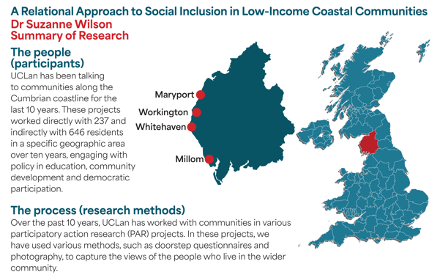
UCLan Research

Slide 6
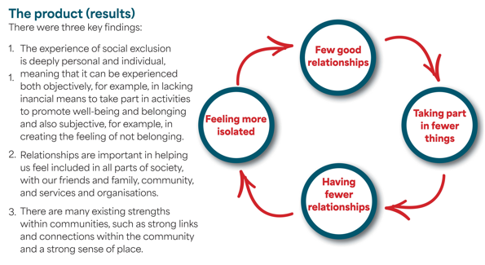
UCLan Research

Slide 7
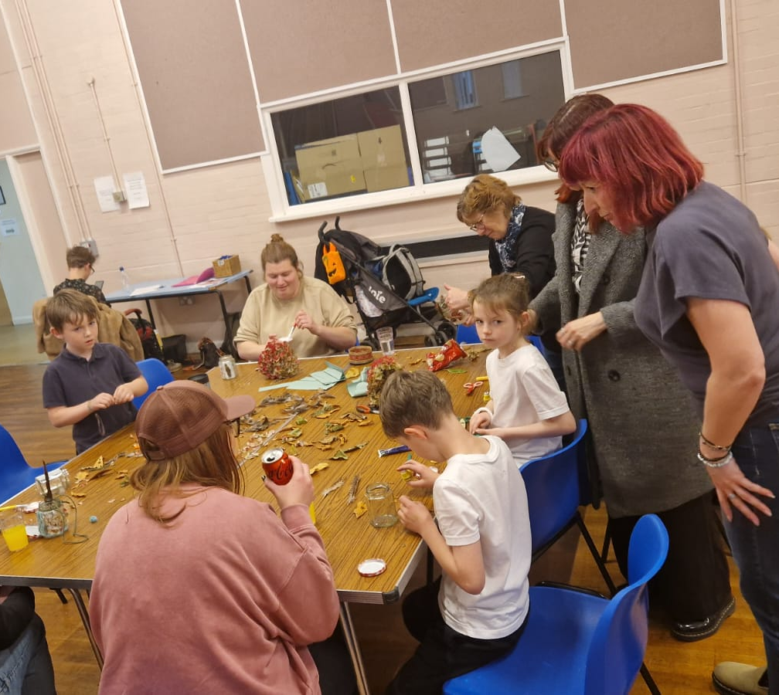
KIND Families at Rosehill Arts Trust
TENT Club: Applying the principles of relational wealth-building and co-producing more detail around how to create the conditions to build relational wealth on different levels.
Family Forum: PAR building relational wealth in families experiencing social inclusion.
“For me and my daughter to be included, it's about her having a voice, having choices in her life, and knowing what her rights are.”

Slide 8
https://youtu.be/CQMVA4vicbs

Slide 9
Relational Wealth Building

Slide 10
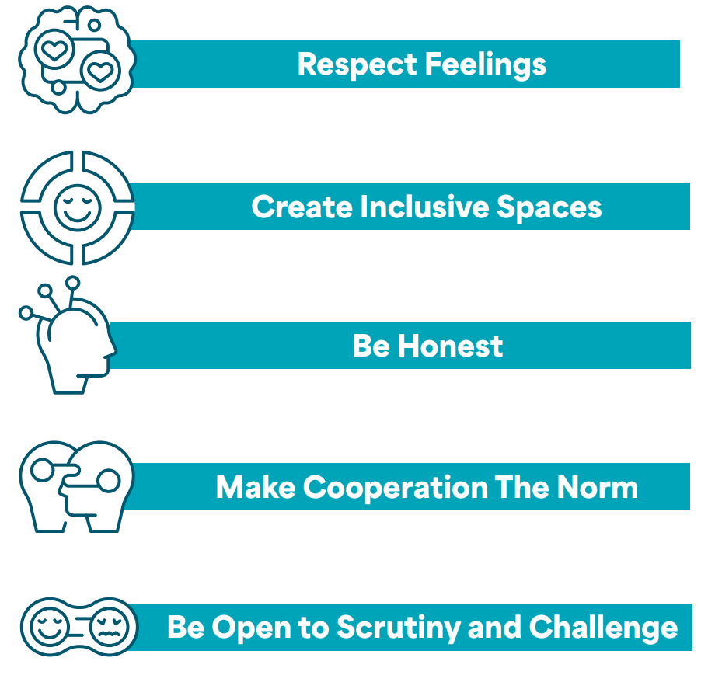
Relational Wealth Building
Just like financial wealth, we think that our overall wellbeing and quality of life can be improved by working with people to build stronger relationships, what we are calling ‘relational wealth’.
Relational wealth is the quality of relationships people experience with each other and with services and institutions. It can be built by creating spaces for people to connect in an equal and accessible way, and is based on the principles of trust, honesty and respect (Wilson, 2024).
Notes:
One research project asked what kind of things would help people feel included and confident to start to build relationships with others. These were:

Slide 11
Creating the Conditions to Build Relational Wealth

Slide 12
Feedback from TENT Community
Respect Feelings | Welcoming atmosphere, with genuine interest in how people are feeling each session. Initiate conversations with adult caregivers. Actively seeking ways to value each member of the community. Diffusing conflict by ‘disagreeing agreeably’ and raising objections calmly. Valuing all creativity, including creativity in processes.
Create Inclusive Space
Be Honest
Make Cooperation the Norm
Be Open to Scrutiny and Challenge

Slide 13
Feedback from TENT Community
Respect Feelings | Shared space and communal food. Focus on using play as a vehicle for establishing a foundation of trust upon which to build. Knowing your voice stands for something. Recognising the necessity of compromise in accommodating access needs and valuing the recognition of lived experience and voice in negotiations. Supporting each other to show courage in their creative choices and a willingness to try new things.
Create Inclusive Space
Be Honest
Make Cooperation the Norm
Be Open to Scrutiny and Challenge

Slide 14
Feedback from TENT Community
Respect Feelings | Recognising each person’s positionality and differences in lived experiences. People being encouraged to express their opinions. Cultivating a culture of listening to understand versus listening to respond. Being open about vulnerabilities at same time as encouraging movement outside of comfort zones. Sharing personal experiences as a way to break down barriers.
Create Inclusive Space
Be Honest
Make Cooperation the Norm
Be Open to Scrutiny and Challenge

Slide 15
Feedback from TENT Community
Respect Feelings | Modelling cooperative behaviour. Building in tidy time at the end of every session. Cultivating a culture of reciprocity. Development of TENT chat discussion space. Looking after the local community, for example through tree planting.
Create Inclusive Space
Be Honest
Make Cooperation the Norm
Be Open to Scrutiny and Challenge

Slide 16
Feedback from TENT Community
Respect Feelings | Learning how to argue without escalating conflict. Approaching relations with the assumption that everyone has general good will towards each other. Recognising that the existence of structural inequalities means different people can have different perspectives. Managing expectations and building resilience, whilst being aware of the potential consequences on others when exercising voice. Agreeing ways to check in to ensure everyone is encouraged to express challenge or suggest change.
Create Inclusive Space
Be Honest
Make Cooperation the Norm
Be Open to Scrutiny and Challenge

Slide 17
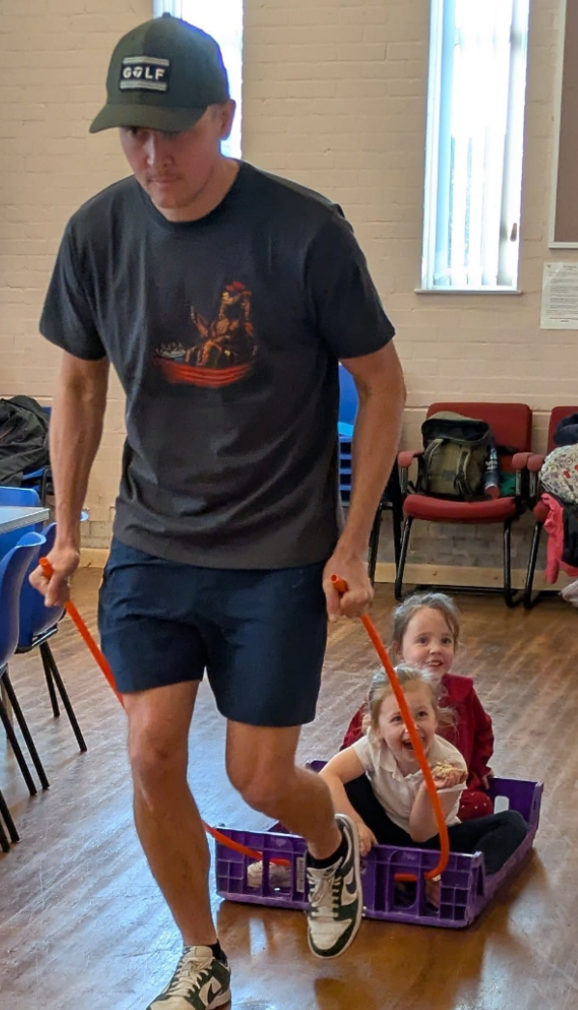
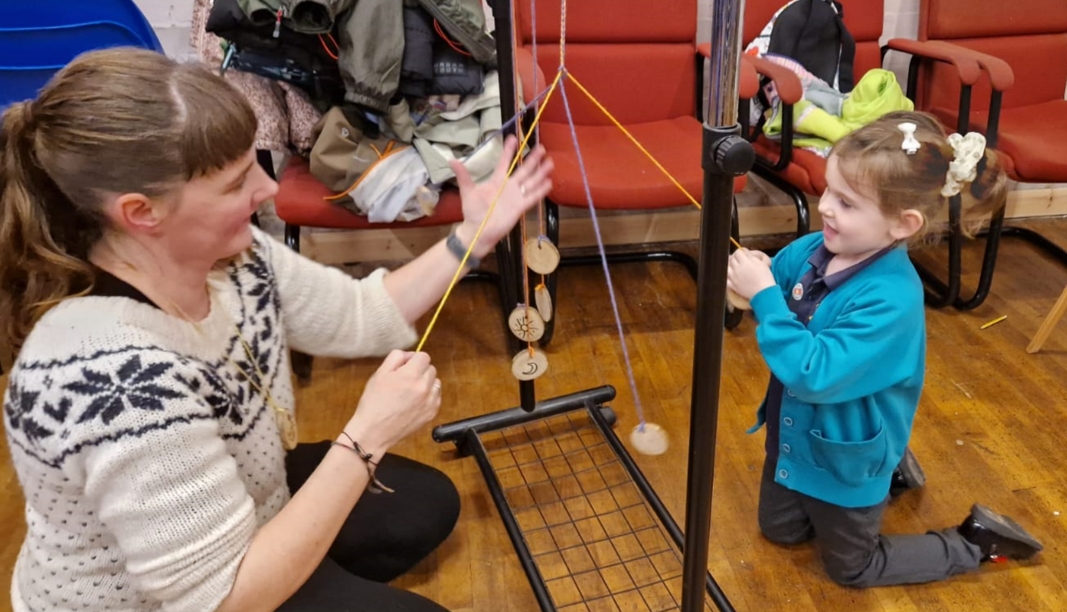
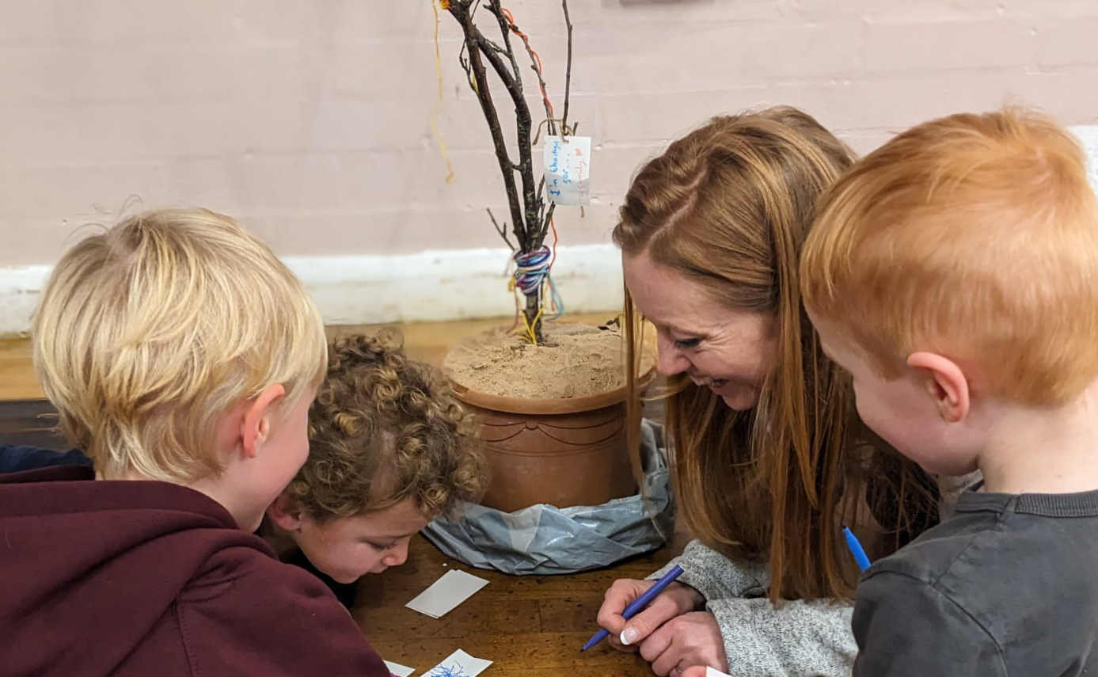
Complex, Inter-Connected and Inter-Dependent Relationships
Stakeholder
Family
TENT Community
Institutions
Notes:
Stakeholder:
The relationship between UCLan and Rosehill was one that emerged slowly and organically. We developed our relationship through regular chat, with no agendas, simply sharing our work. The nucleus of our relationships has always been in the shared values of social justice. We started from that, then when the right conditions were in place, we co-produced Family Forum.
Family:
Although we haven’t yet explicitly asked families about how TENT has supported interactions between family members, almost all family play together during the TENT sessions, despite not being directed to do so. We hope that TENT is providing new ways for families to connect.
Families have built trusting relationships with TENT practitioners, particularly with the project lead.
TENT community:
Members of the TENT community do talk and interact well during sessions, but have not connected beyond this.
There are few pre-existing relationships within this group.
Institutions:
Formal institutions have expressed interest in implementing the results of the research. However, Rosehill have expressed frustration at the lack of engagement from formal institutions.
Families have expressed positive relationships with their schools, distant relationships with the local Council and frustrated relationships with the heath service.

Slide 18
Family Forum for Social Inclusion

Slide 19
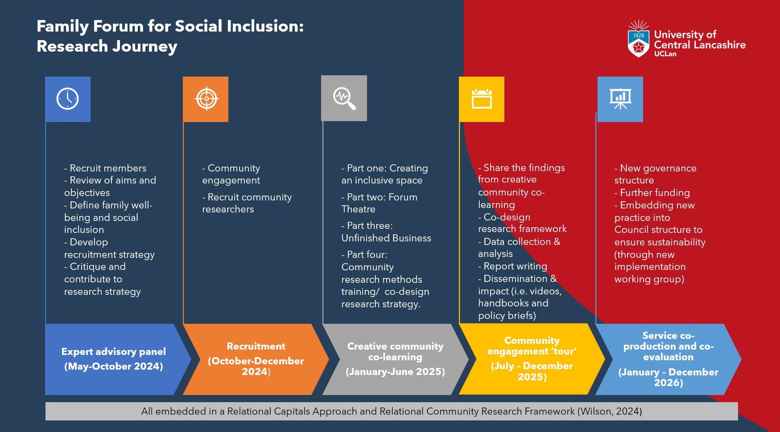
Research Journey: In Theory

Slide 20
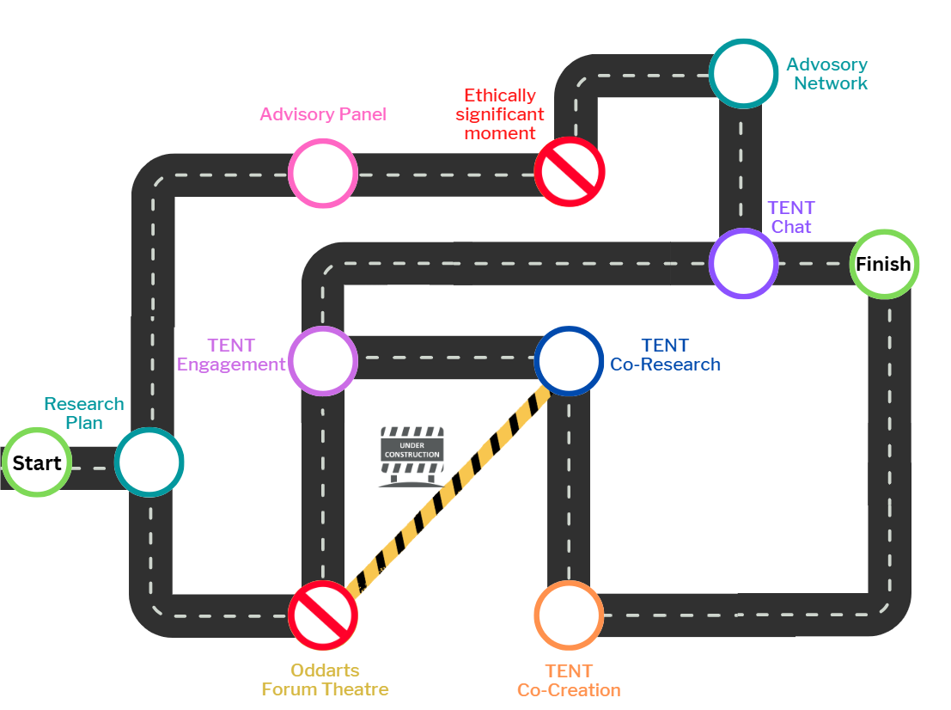
Research Journey: The Reality

Slide 21
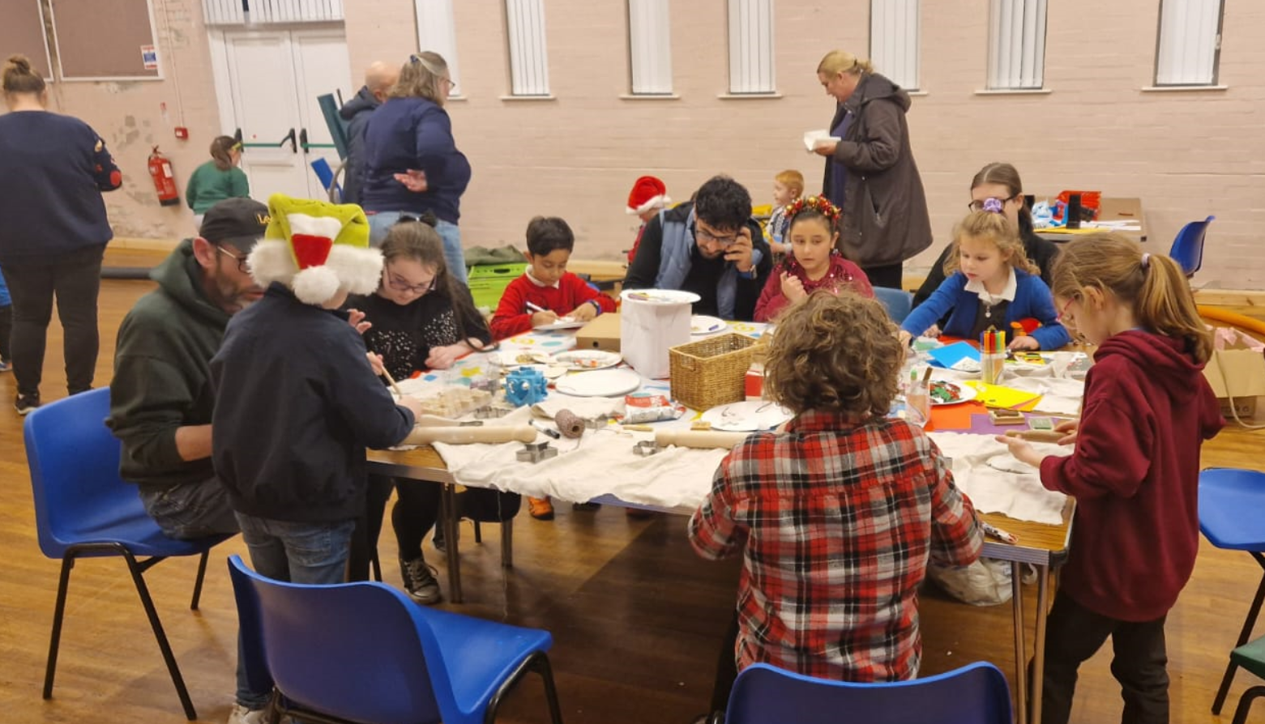
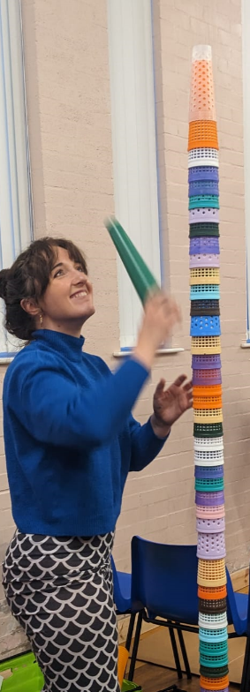
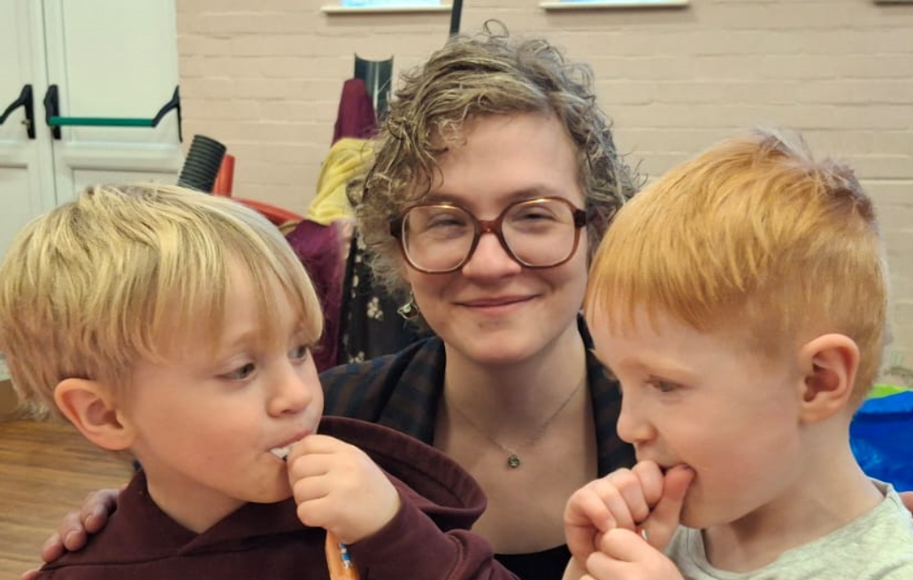
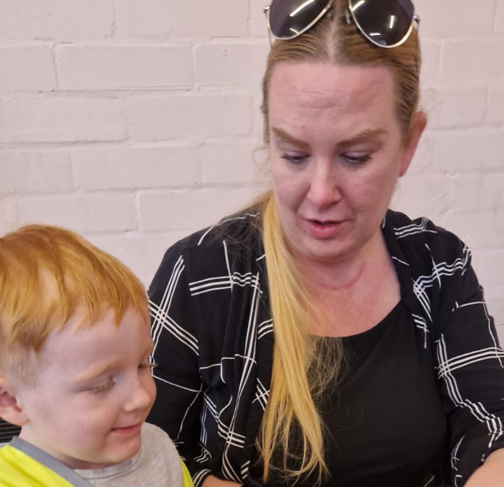
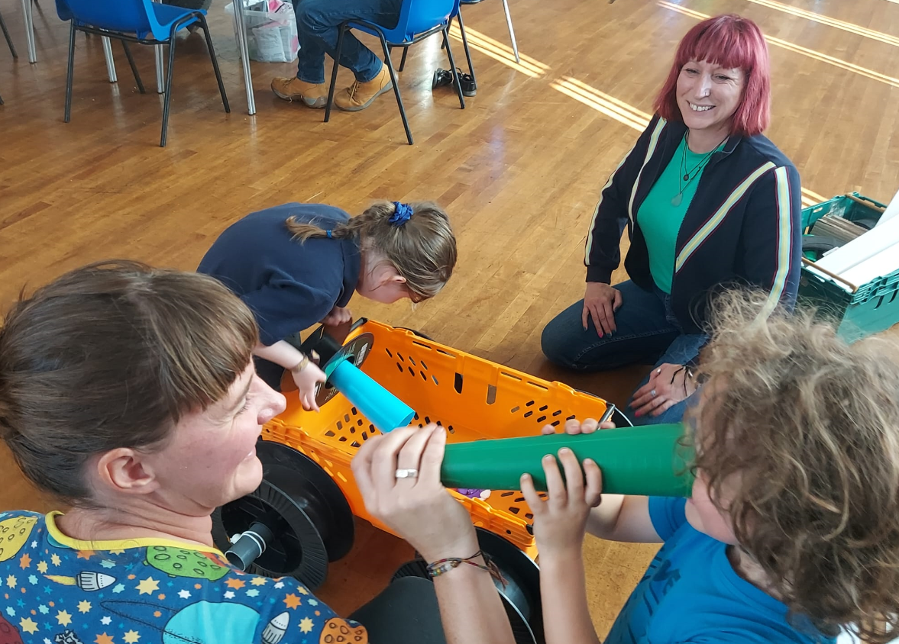
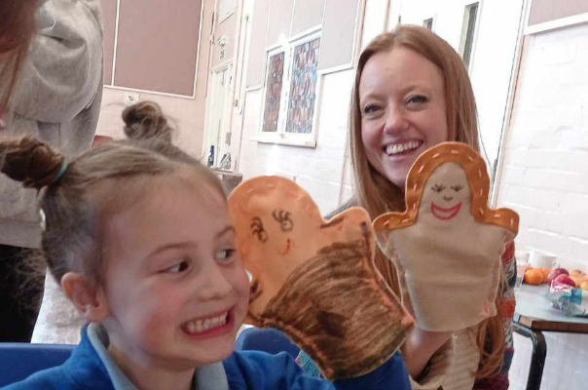
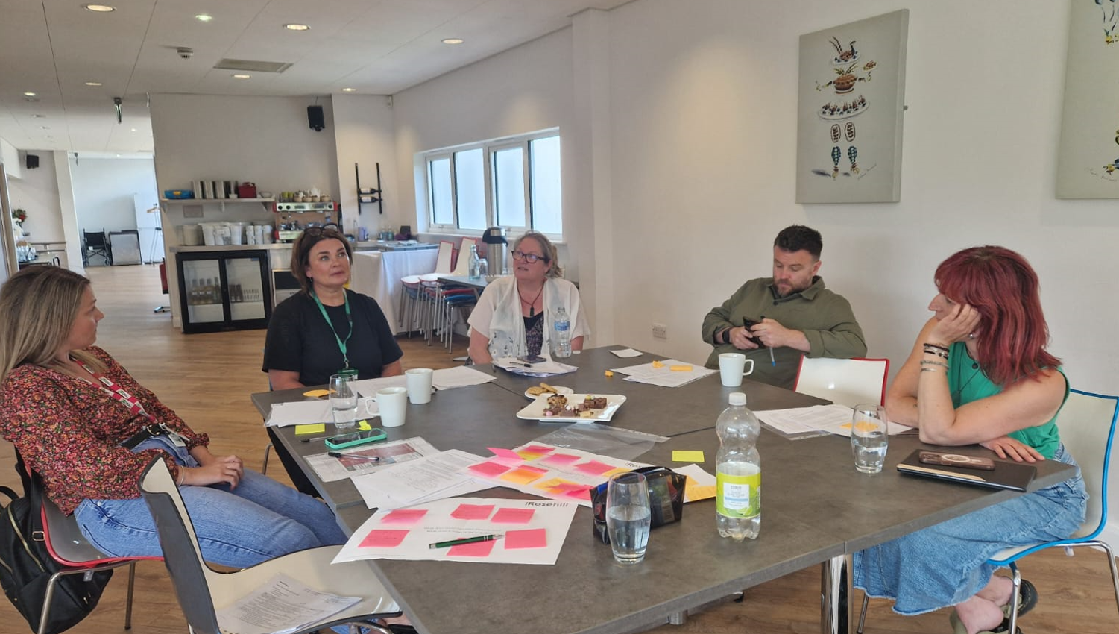
The Family Forum Team
TENT Community
TENT Practitioners
TENT Advisory Network
Professional Researcher
Community Researcher

Slide 22
The TENT Community (participants)
Grandparents
(n=3)
Fathers
(n=3)
Children (5-11 yrs)
(n=14)
Mothers
(n=6)

Slide 23
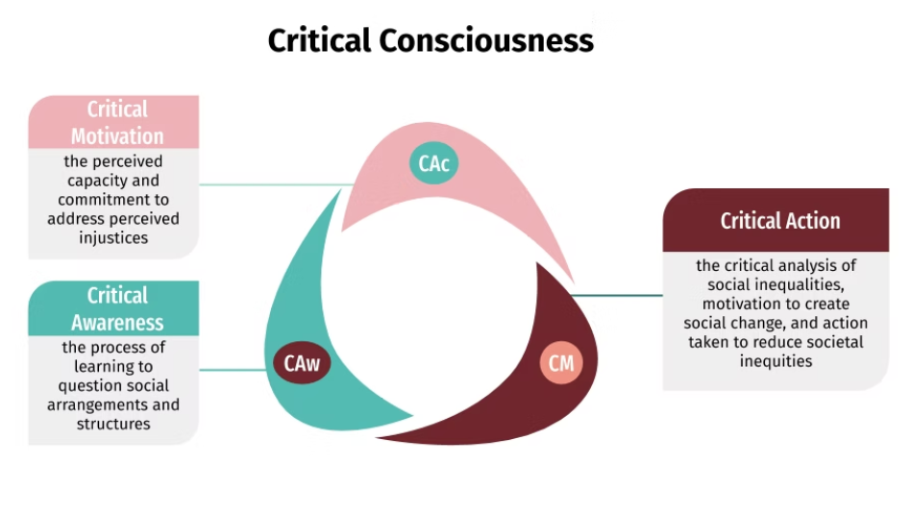
Theoretical Framework (Freire, 1970)
Stage One: Exploring Inclusive Relationships (Critical Motivation)
Gently introduce families to participatory research, with a focus on people and places where we feel included, and the role of relationships within this.
Stage Two: Understanding our Voices, Choices and Rights (Critical Awareness)
Work with families in more depth, exploring where they feel they should be able to use their voices, have choices and know their rights.
Stage Three: Claiming our Voices, Choices and Rights (Critical Action)
Review materials produced so far and how these can be used to produce training tools for services whose role it is to support families.
Diemer, M. A., Rapa, L. J., Voight, A. M., & McWhirter, E. H. (2016). Critical consciousness: A developmental approach to addressing marginalization and oppression. Child Development Perspectives, 10(4), 216-221. doi.org/10.1111/cdep.12193

Slide 24
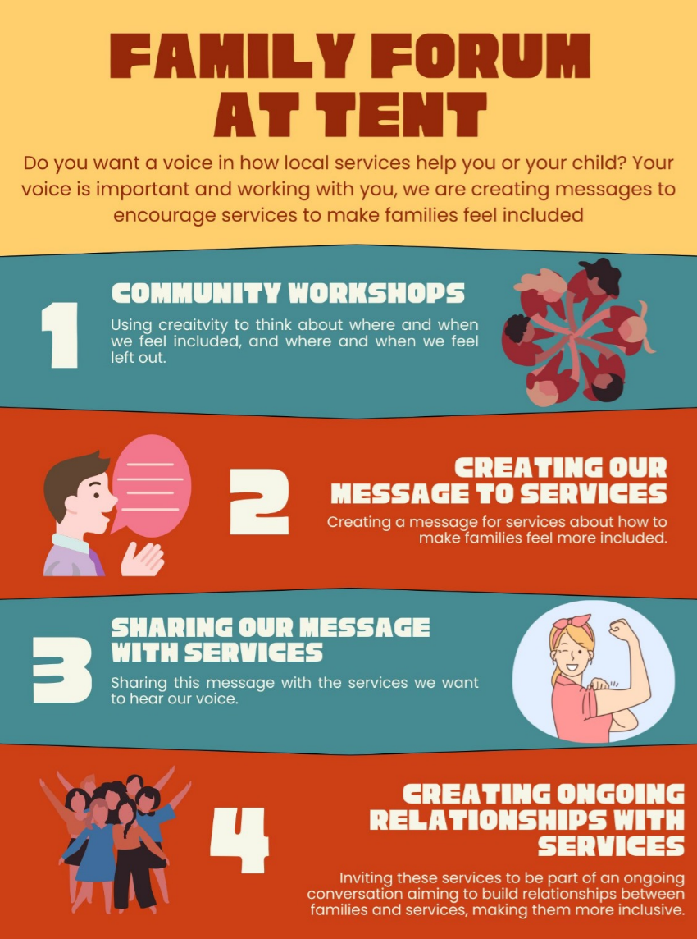
Overview
Aims:
Understand what impacts family well-being and inclusion.
Develop stronger relational practice in children and family services.
Explore the benefits and impacts of relational practice in arts-based delivery

Slide 25
Creative Workshop
Notes:
The creative sessions will introduce several creative tools that are particularly effective in building connections and relationships within the family system, the community, and formal organisations. Through providing the space for researchers and practitioners to reflect on the role of relationships and creativity in their work, this workshop is of great relevance in providing real-life, hands-on opportunities to practice creative tools with families experiencing social exclusion

Slide 26
Creative Relational Practice
Choose an activity:
Puppet making
Inclusive place-making
How would you use this to understand social inclusion at a family level? What kind of data would you anticipate?
Try out the activity

Slide 27
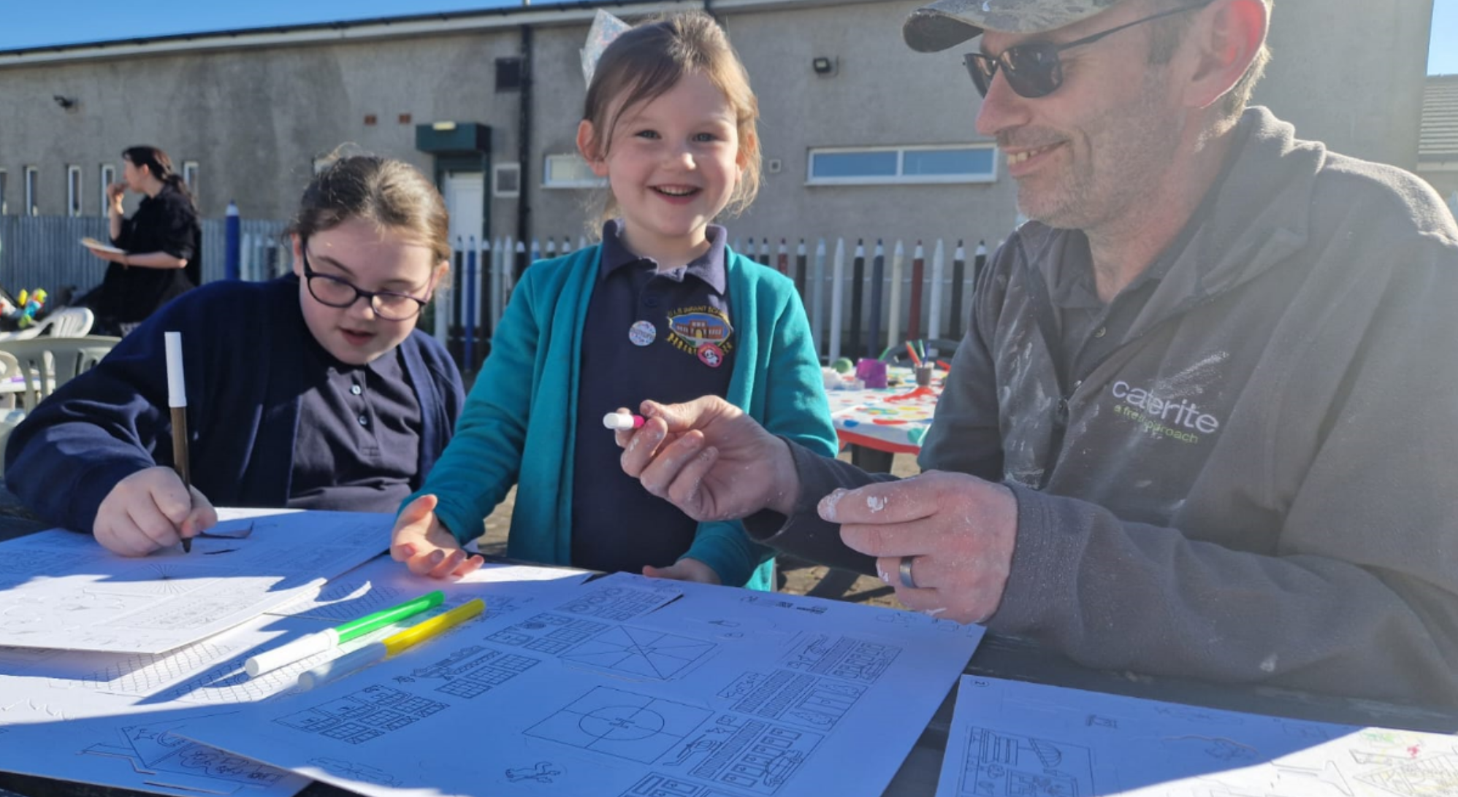
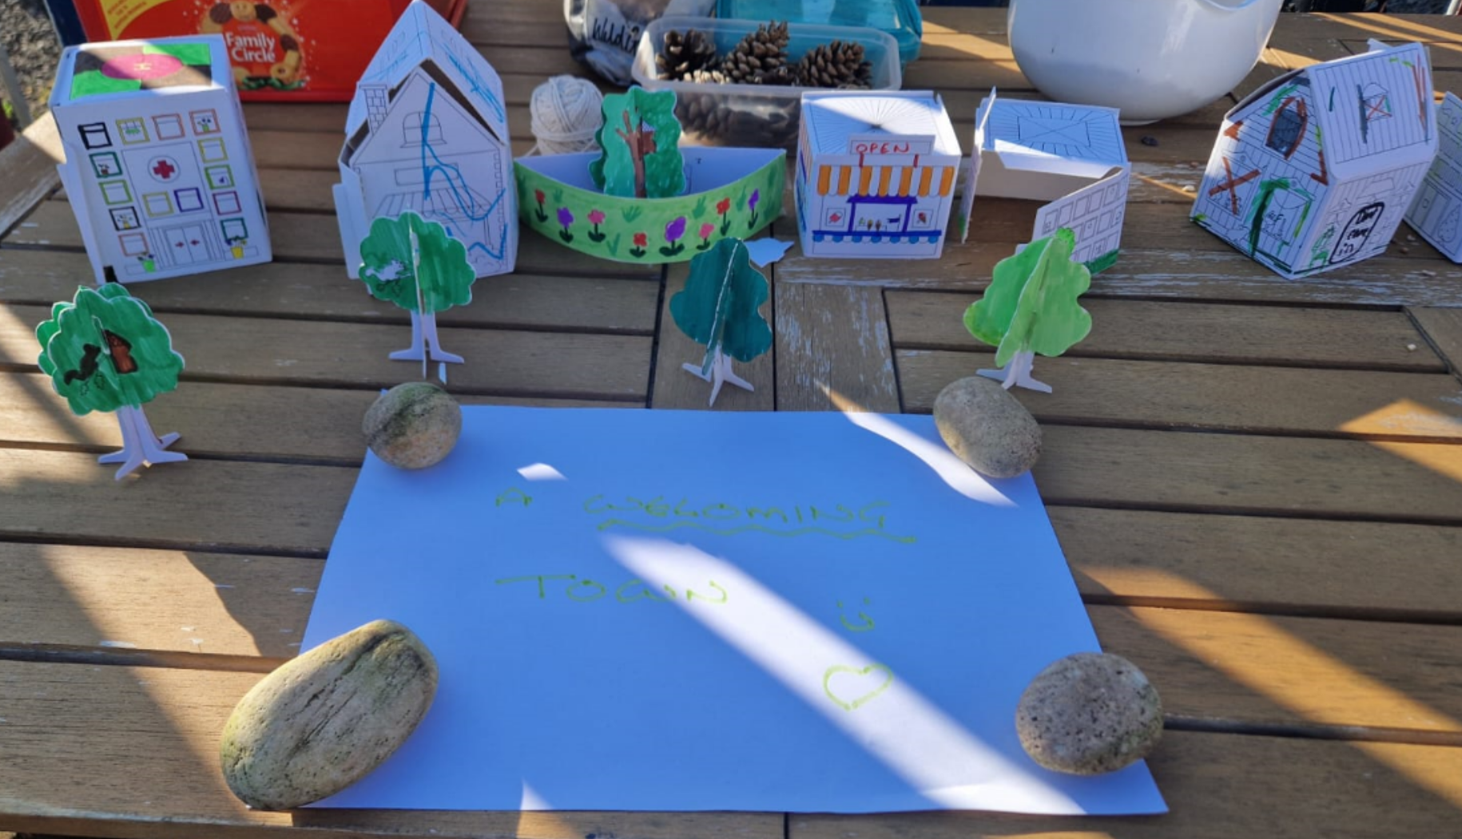
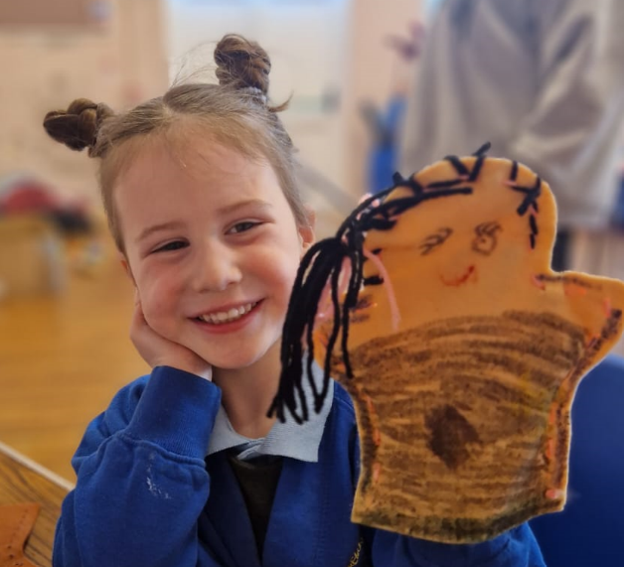
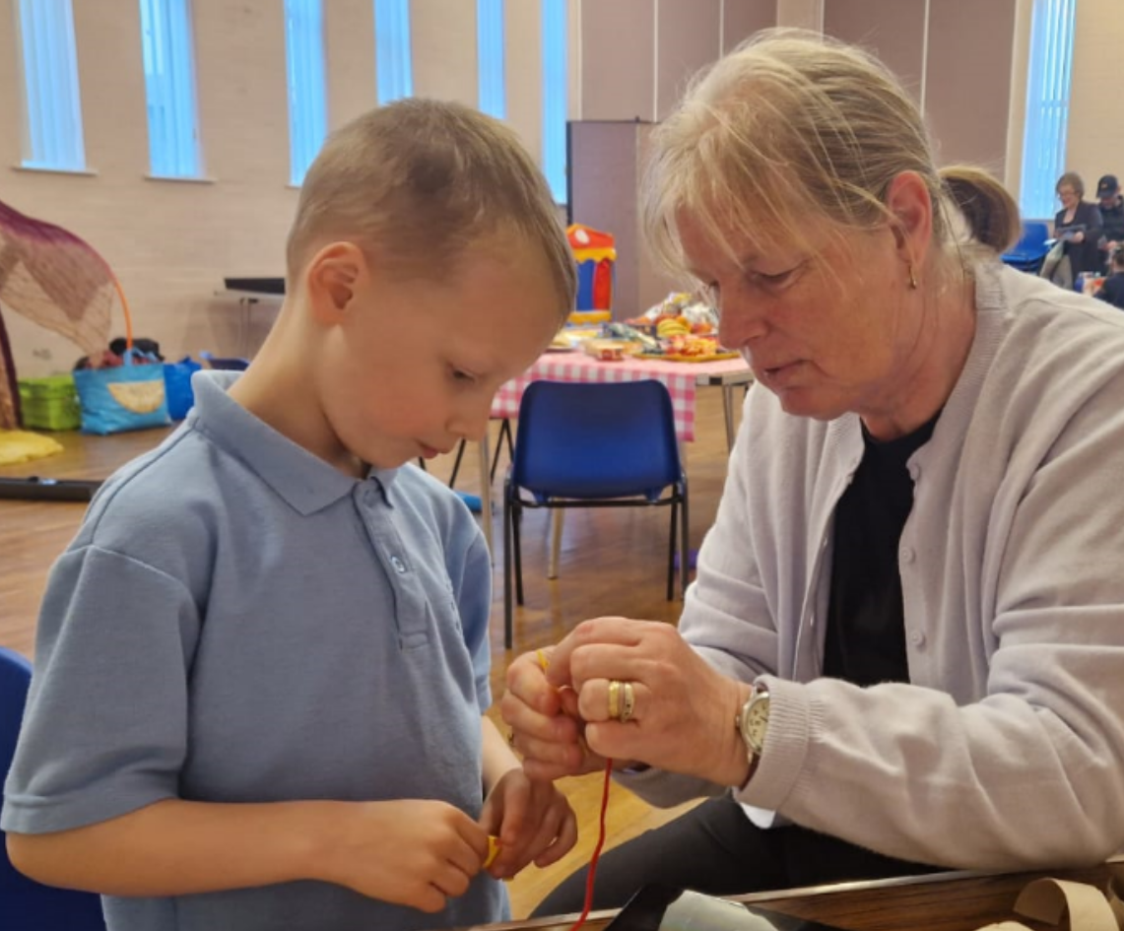
Go Play!
How did you find it?
Do you think families would engage together with this method?
What are the challenges and barriers you would anticipate encountering?
Do you have any recommendations for developing this practice?
Is there any learning you will be taking away with you?

Slide 28
Wrapping Up
Thank you for your time!
Summary of learning from the session?
Any questions?
Notes:
INCLUSION
Feeling included
Reportedly makes children feel happy.
An example was given of welcoming a new girl at school who has migrated from Africa. A group of girls have bene teaching her English using signing and card. The girls have been making her feel welcome by smiling at her, talking to her and sitting with her.
When playing with the puppets, I started a conversation with one girl. We made friends and started playing tig, playing games is fun and helped to make friends.
Welcoming town
“Big blue house”: Younger children felt that larger spaces, with places for them to play, were welcoming.
“I like to smell the flowers”: A number of children commented that green, outdoor spaces made them feel welcome.
Adults and children said they liked outdoor spaces with animals.
A hospital was coloured in by an adult tidily with bright colours. Hospitals, as opposed to primary care, were perceived as being welcoming places where people felt well cared for and heard. Conversely, one father shared a story of his young son being unwell but felt dismissed by a GP who said it was a virus. After speaking to a friend whose son had diabetes, the mother had to “fight” for tests for diabetes, which was in fact the condition his son had. A mother explained her “fight” with the healthcare system regarding her son's skin condition, and that this impacts her wellbeing as she feels frustrated with not being able to alleviate her son's suffering.
EXCLUSION
Feeling excluded
Reportedly makes children feel sad.
Examples of not being included, picked last in PE, although children reported feeling mostly included.
Unwelcoming town
Broken windows: Adults and children both created buildings with broken windows, to symbolise vandalism and lack of maintenance.
Privatised hospital: One adult energetically shared her concerns about the risk of the privatisation of the health service and concerns about the marketisation of public services in general.
A fire station with no fire engine: One adult created a fire station with the fire engines cut out to symbolise the significant cuts to public services.
Dying plants and frees: Both adults and children drew dying plants and trees as creating unwelcoming spaces.

Slide 29
Dr Suzanne Wilson swilson21@uclan.ac.uk

