Slide 1
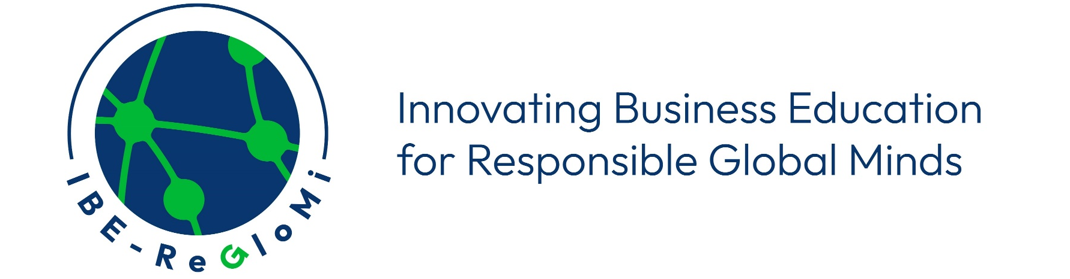




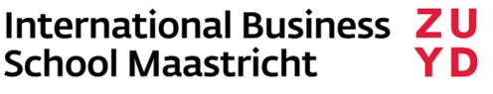



Global Investments, Sustainable Returns: Rethinking FDI Through the Lens of Sustainability and Intergenerational Equity
Dr Panagiotis Kontakos
UCLan Cyprus
Date June 11–12, 2025

Slide 2
1. Why FDI and Education?
Foreign Direct Investment (FDI) has long been associated with economic growth and globalisation.
But FDI is no longer just a financial decision—it’s a socio-environmental commitment.
Education must adapt to this new global reality.
Key Idea: We must teach students to critically engage with capital flows through the lens of sustainability, ethics, and long-term societal value.
2
Notes:
2

Slide 3
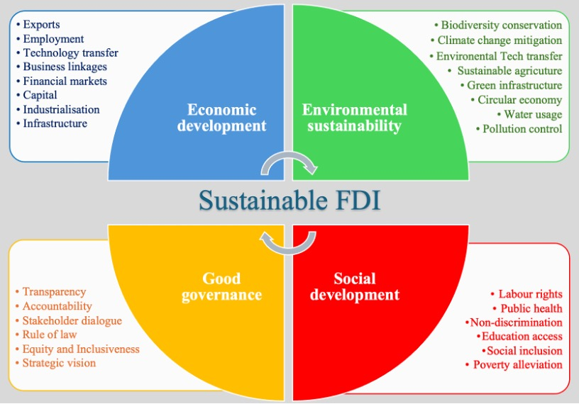
2. Defining Sustainable FDI (SFDI)
Investment that generates financial returns while also creating positive social and environmental impacts.
Aligns with the UN Sustainable Development Goals and ESG frameworks.
“Sustainable FDI is
no longer optional;
it is imperative.”
Fig. 1: Dimensions of Sustainable FDI. Source: Kontakos (2025)
3
Notes:
3

Slide 4
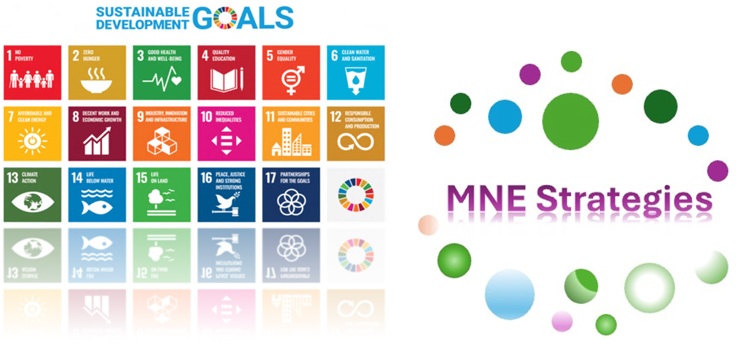
2. Defining Sustainable FDI (SFDI), cont.
E.g. the strategic spectrum of “international—multidomestic—global—transnational” has long been foundational in international business theory.
Sustainability adds a new layer to this balance.
MNE Managers must consider how these strategies support sustainable value creation while responding to local and global challenges.
Fig. 2: Reflections of Sustainable Development Goals on MNE Strategies,
adapted from the United Nations (2024). Source: Kontakos (2025)
4
Notes:
4

Slide 5
3. The Missing Link – Education
How is FDI connected to educational innovation?
Real-World Pedagogy: FDI case studies allow students to analyse complex, real-time policy and investment dilemmas.
Systems Thinking: Students see how investment decisions impact ecosystems, communities, and international governance.
Ethical Reasoning: Teaching around dilemmas in ESG trade-offs builds responsible leadership.
5
Notes:
5

Slide 6
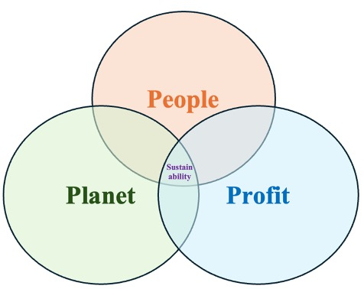
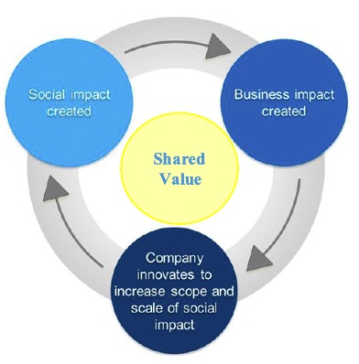
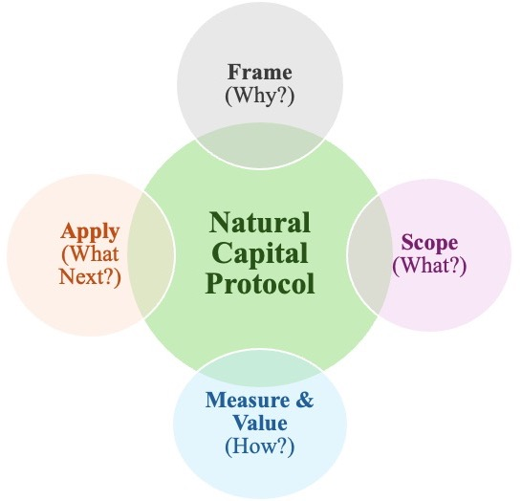
4. Models that Connect FDI & Curriculum
From my book, several models are used in business education:
Triple Bottom Line (TBL, Elkington 1997, 2018): Profit, People, Planet
Shared Value Model (Porter & Kramer, 2011): FDI as a tool for societal good
Natural Capital Protocol (2016): Teaching students to quantify environmental externalities
These models help students connect economic value with intergenerational responsibility.
Fig. 2,3,4: The Triple Bottom Line (TBL) Framework, The Shared Value Model, Natural Capital Protocol Simplified. Source: Kontakos (2025)
6
Notes:
6

Slide 7
5. Teaching Tools and Approaches
Project-Based Learning: Students simulate green investment decisions (e.g. solar plant in a developing country with community input).
Interdisciplinary Case Studies: Merge finance, ethics, environment, and policy – grounded in real FDI contexts.
Cross-Cultural and Regional Analysis: FDI flows in the Eastern Mediterranean as learning platforms for global-local dynamics.
7
Notes:
7

Slide 8
6. Learning Outcomes – Shaping Responsible Global Minds
Students will graduate with:
Critical investment literacy
Civic and intercultural competencies
Strategic foresight in a volatile world
Commitment to inclusive growth and sustainability
Business schools become incubators for investors of conscience.
8
Notes:
8

Slide 9
7. Policy and Institutional Implications
Curricular innovation requires interdisciplinary design and external partnerships (e.g. with multilateral organisations).
Embed sustainability not only in modules but in assessment tools, partnerships, and experiential learning models.
Interdisciplinary Case Studies: Merge finance, ethics, environment, and policy – grounded in real FDI contexts.
9
Notes:
9

Slide 10
8. Conclusion – A Call to Educators
Let’s shift the narrative:
From FDI as a financial metric → to FDI as a pedagogical tool for global responsibility.
Business education must not only prepare students to manage investments—it must teach them to reimagine their purpose.
10
Notes:
10

Slide 11
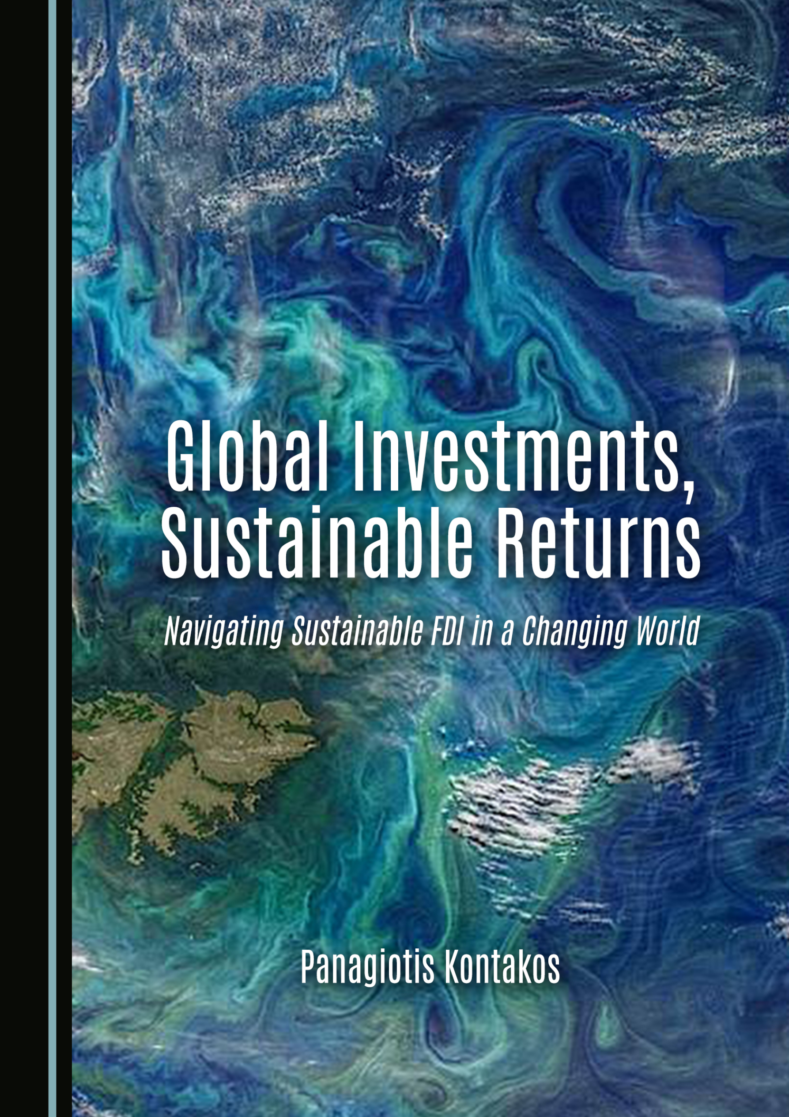
9. Thank You
📘 Kontakos, P. (2025) Global Investments, Sustainable Returns: Navigating Sustainable FDI in a Changing World. Newcastle upon Tyne: Cambridge Scholars Publishing.
https://www.cambridgescholars.com/product/978-1-0364-4731-1
LinkedIn Profile: https://www.linkedin.com/in/pdkontakos/
Email: pkontakos@uclan.ac.uk
#FDI #Sustainability #GlobalMinds
11
Notes:
11

Slide 12
Bibliography
Kontakos, P. (2025). Global Investments, Sustainable Returns: Navigating Sustainable FDI in a Changing World. Newcastle upon Tyne: Cambridge Scholars Publishing. ISBN 978‑1‑0364‑4731‑1.
Kontakos, P. (2025, forthcoming). Foreign Direct Investment in the Eastern Mediterranean: Sustainability and Cultural Alignment. Newcastle upon Tyne: Cambridge Scholars Publishing.
Kontakos, P. (2025, forthcoming). Regional Perspectives on Sustainable FDI: Trends, Challenges, and Strategic Pathways In Developed, Emerging, And Developing Economies, New Economist / Novi Ekonomist.
Kontakos, P. (2023). Economic challenges in a globally transitional era: contemporary perspectives, New Economist / Novi Ekonomist, 17(34), pp. 41–48. doi:10.7251/NOEEN2334041K.
12
Notes:
12

Slide 13
Bibliography (cont.)
Kontakos, P. (2024). Risk Management in Sustainable Foreign Direct Investments. Paper presented at the ICIB 2024: Trends in Sustainable International Business, Zuyd University of Applied Sciences, Maastricht, Netherlands, 27 September. Available at: https://www.researchgate.net/publication/387328553_Risk_Management_in_Sustainable_Foreign_Direct_Investments
Kontakos, P. (2024). Mechanisms and Tools for Financing Sustainable Investments. Paper presented at the ICIB 2024: Trends in Sustainable International Business, Zuyd University of Applied Sciences, Maastricht, Netherlands, 27 September. Available at: https://www.researchgate.net/publication/387328400_Mechanisms_and_Tools_for_Financing_Sustainable_Investments
13
Notes:
13

Slide 14
Bibliography
Kontakos, P. (2024). Sustainable Foreign Direct Investments: Key Trends in 2024. Paper presented at the Nepal Global South Summit – GSFN Annual Conference 2024, Kathmandu, 18–20 December 2024. Available at: https://www.researchgate.net/publication/387327961_Sustainable_Foreign_Direct_Investments_Key_Trends_in_2024
Karayianni, E., Kontakos, P., Bitzenis, A. and Sergi, A. (2023). Cypriot Diaspora Direct Investment Patterns in times of Financial Crisis, Journal of East-West Business, 29(3), pp. 285–306. doi:10.1080/10669868.2023.2198514
Kontakos, P. (2012). Foreign Direct Investment in Perspective: Evidence from Mergers and Acquisitions in the Turkish Banking Sector. In: Bitzenis, A., Vlachos, V.A., Papadimitriou, P. (eds) Mergers and Acquisitions as the Pillar of Foreign Direct Investment. Palgrave Macmillan, New York. https://doi.org/10.1057/9781137031556_13
14
Notes:
14

