Slide 1
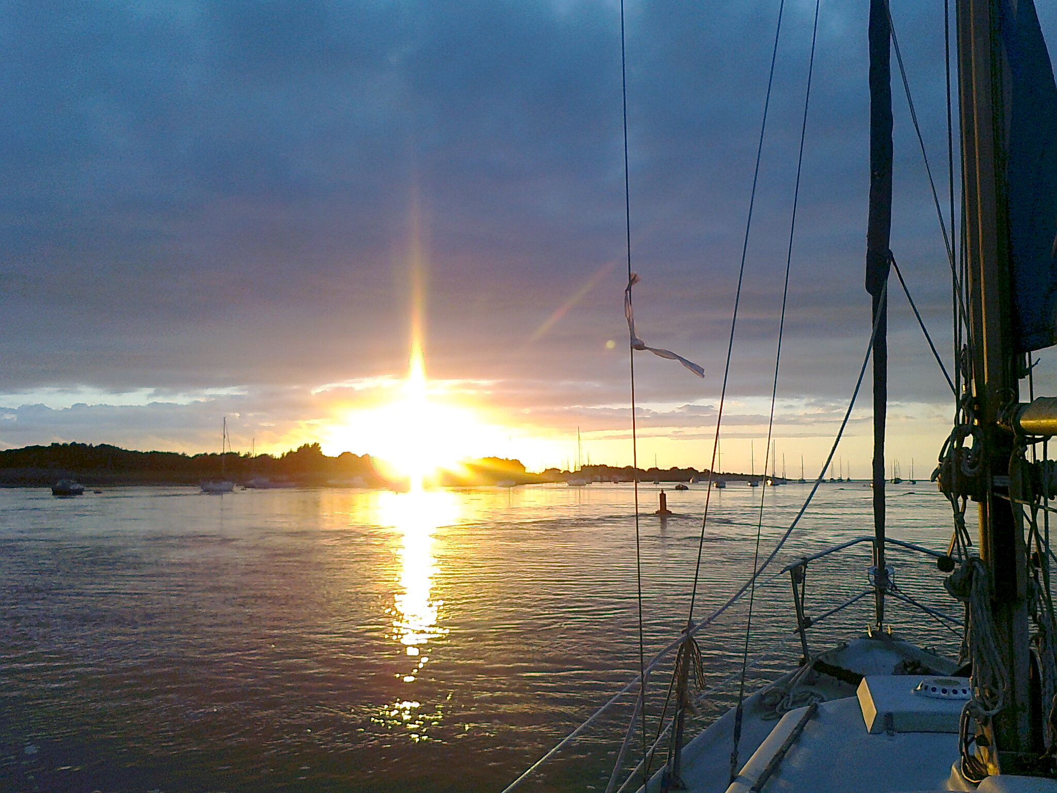
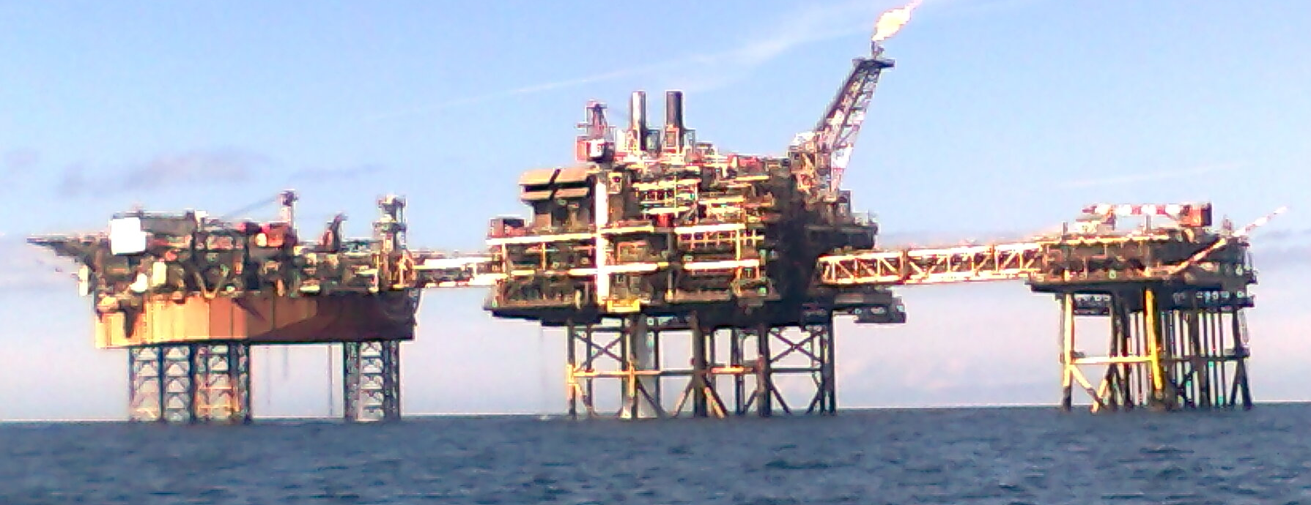
Michael Clark
MARINE SPATIAL PLANNING SCOPE & LIMITATIONS
Visitor moorings for UK small craft: a dangerous neglect?
Paper for
1st Marine & Coastal Policy Forum
University of Plymouth, 24th June 2011
Context
Increasingly hostile environment for recreational and small scale commercial boat use. ‘Self-Destruct’ theory of tourism (Holder1988 in Shaw & Williams 2002): some activities best not facilitated or encouraged. Increased regulation of coastal & near shore activity: management, plans & (likely) prohibitions. Follows great expansion of offshore energy (gas, gas storage, oil, wind) & concern about fish stocks & marine ecosystems. Mapping of vulnerable areas underway.
Marine conservation driving force behind current initiatives. Consultation ongoing. Questionable if it engages with or adequately represents stakeholder interests & casual recreation. Presumption against activity that disturbs or might harm wildlife. Non negotiable ethic of conservation backed by scientific data (eg. Davenport 2006). Marine Spatial Planning still in process of development.
UK has done little to implement EU Directive on marine safety regarding ‘place of refuge’ ... any naturally or artificially sheltered area which may be used as a shelter by a ship or craft under conditions likely to endanger its safety (EU 1998). Little use of EU funds to upgrade small (mainly inshore fishing) harbours in UK. Anchoring integral to rights of navigation, but increasingly seen as harmful. Provision of visitor moorings is haphazard, subject to complex and contested regulation and not to be relied on.
Marina development proposals are generally associated with real estate speculation, often opposed as unwelcome development and generally not facilitated by sympathetic public bodies. May be seen to be in conflict with port activity. Places with marina berths (eg Conwy, Liverpool, Fleetwood ) are not necessarily best for recreational boating activity (tides etc.). Other locations in North West with good recreational boating potential lack necessary moorings or pontoons (eg. Bangor, Barrow) or have had schemes abandoned (Morecambe).
ALL POINTS TO NEED FOR BETTER INTEGRATION BETWEEN COASTAL AND INSHORE MARINE ACTIVITIES, AND FOR CONFLICT BETWEEN USES AND INTEREST GROUPS TO BE BETTER MANAGED. IN OTHER WORDS, A NEED FOR MARINE SPATIAL PLANNING FOR ALL ACTIVITIES, USERS & INTERESTS.
Visitor moorings:
Complex English law concerning moorings (Crown Estate 2011, RYA 2011)
No requirement that chart & almanac information is correct: moorings may not be there when needed.
Negative attitudes to provision: ‘name & shame’ pursuit of non payers.
Underlying rights – RYA challenge right to charge for some moorings. Crown Estate license moorings.
Relatively good provision in Scotland: different legal arrangements and tourist development history.
Matter of cost of provision of moorings / charge necessary to cover these costs.
Liability issues: ‘borrowing’ may damage tackle, or put using vessel at risk.
Disadvantages of anchoring:
Damage to marine environment
Unreliable anchor gear
Incompetent use
Risk to vessel if anchor does not hold or is lost
Accidents to crew.
Scope for further research / need to:
Better incorporate recreational and small scale commercial boat use into marine spatial planning and into associated land use development plans and management schemes.
Map current visitor mooring provision, 24 hour access (not limited by state of tide) harbours and other places of safety to identify gaps and locations where improved provision will benefit inshore vessels and ensure EU marine safety requirements.
Compare uptake of EU funds for marine safety and the marine economy.
Evaluate consultations undertaken as part of marine planning and conservation initiatives in the UK. Are these as stage managed and sham as they appear to be?
Investigate boating industry and boat user group support for a minimum level of mooring provision, and identify mechanisms by which this may be facilitated.
Identify locations best left undisturbed. Facilitate this by ensuring that the full range of small scale recreational and commercial marine activity can take place elsewhere.
ACADEMIC RESEARCH IS A MAJOR PLAYER IN THE CASE FOR NEW (RESTRICTIVE) MARINE CONSERVATION INITIATIVES, BUT THERE IS LITTLE PUBLISHED ON THE PROCESSES BY WHICH SUCH POLICIES ARE DECIDED, OR ON THE UNDERLYING GEOGRAPHIES (RECREATIONAL BOATING, INSHORE FISHING, INFORMAL COASTAL RECREATION...) AND THEIR ASSOCIATED ECONOMIES AND EMPLOYMENT.
References:
Crown Estate (2011) Visitor mooring regulation uk http://www.thecrownestate.co.uk/moorings_law
Davenport J & Davenport JL (2006), The impact of tourism and personal leisure transport on coastal environments: A review Estuarine, Coastal and Shelf Science, 67:1-2, March, 280-292
EU, COUNCIL DIRECTIVE 98/18/EC of 17 March1998 on safety rules and standards for passenger ships(OJ L 144, 15.5.1998, p. 1), 6 http://eur-lex.europa.eu/LexUriServ/LexUriServ.do?uri=CONSLEG:1998L0018:20050101:EN:PDF
RYA (2011) Mooring Law, laying of moorings in tidal waters http://www.rya.org.uk/infoadvice/clubsclass/Premises/Pages/mooringlaw.aspx
Shaw G & Wiliams A M (2002) Critical issues in tourism: a geographical perspective, Blackwell, 96.
School of Built & Natural Environment, UCLan, Preston, PR1 2HE mclark@uclan.ac.uk 17 June 2011.

