Slide 1
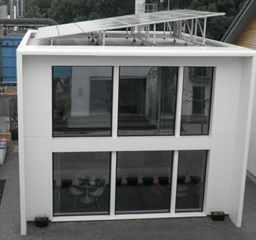
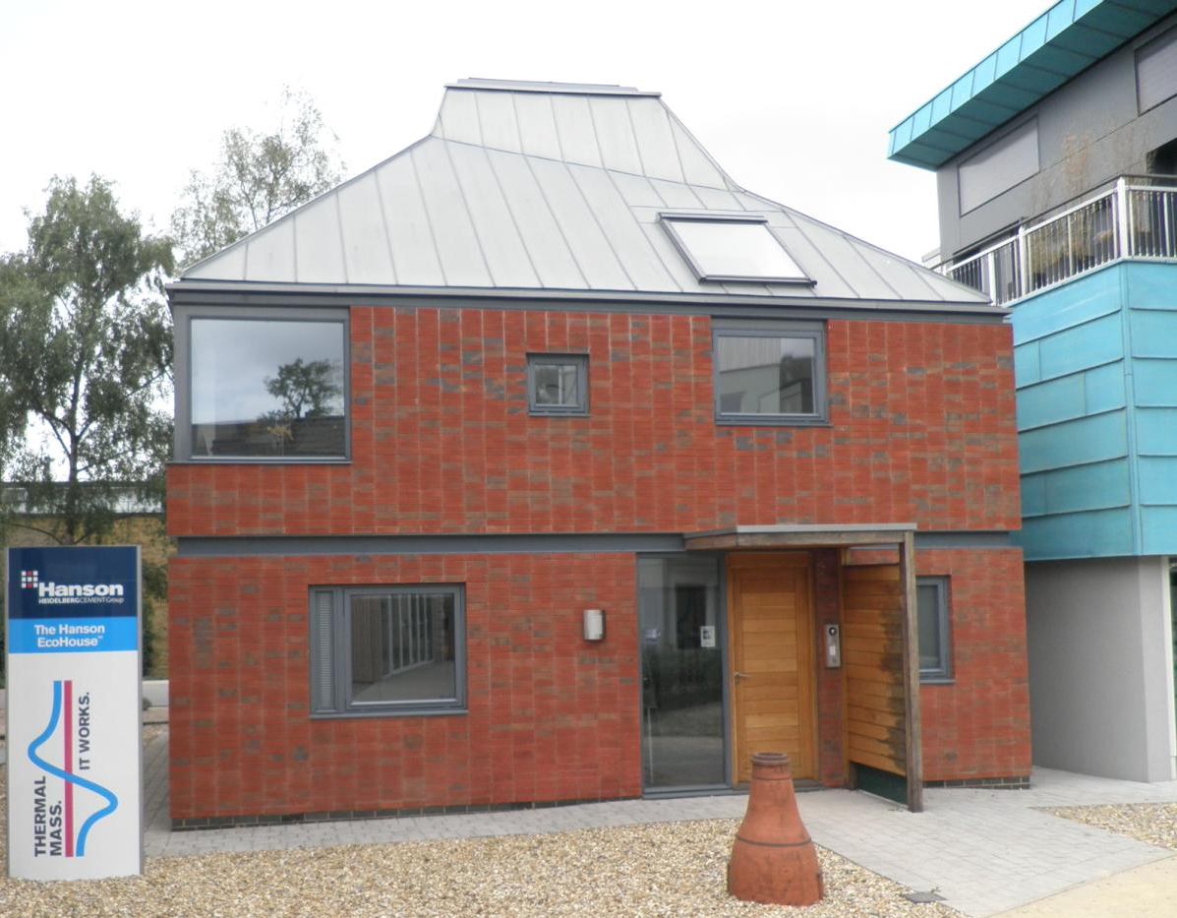
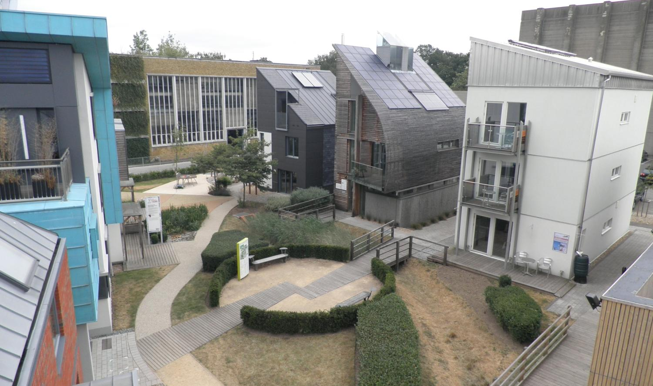
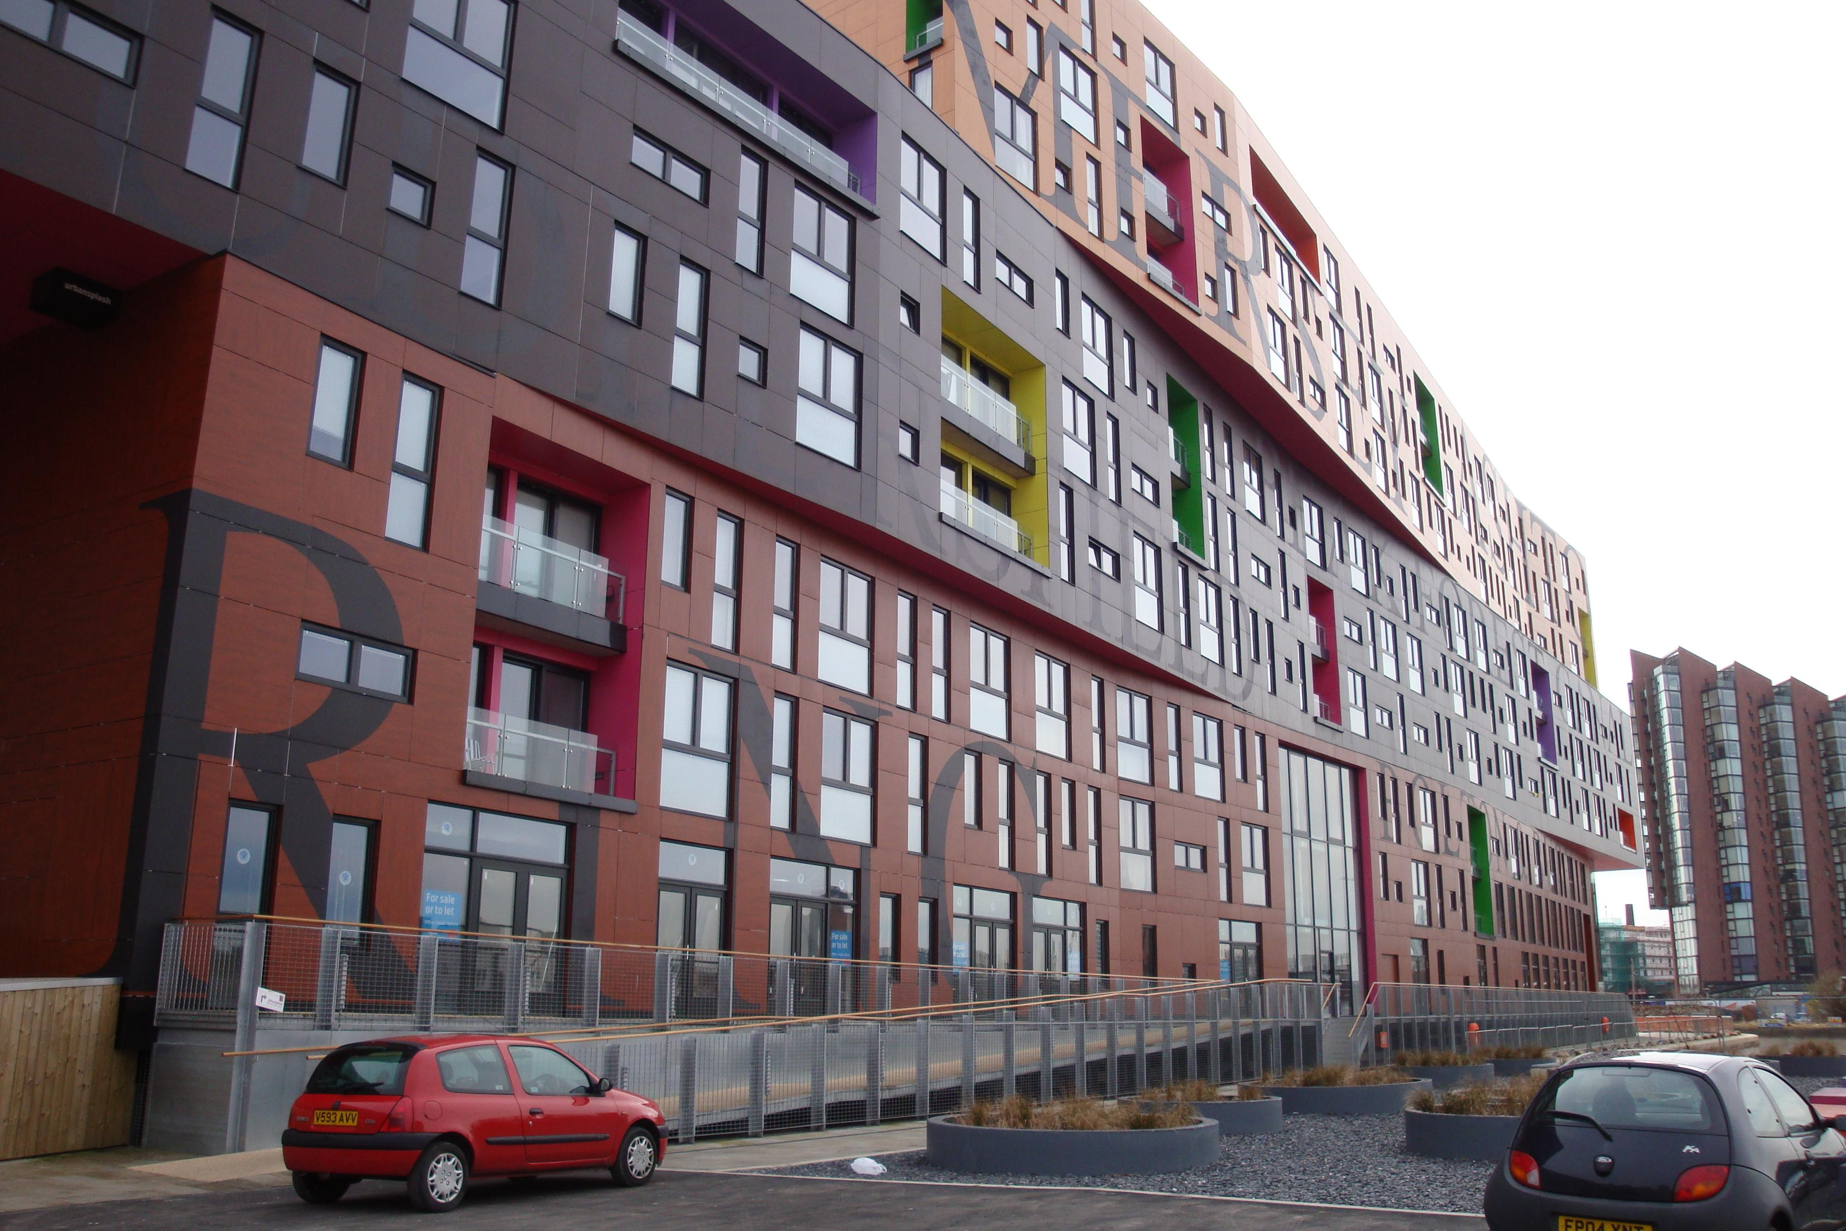
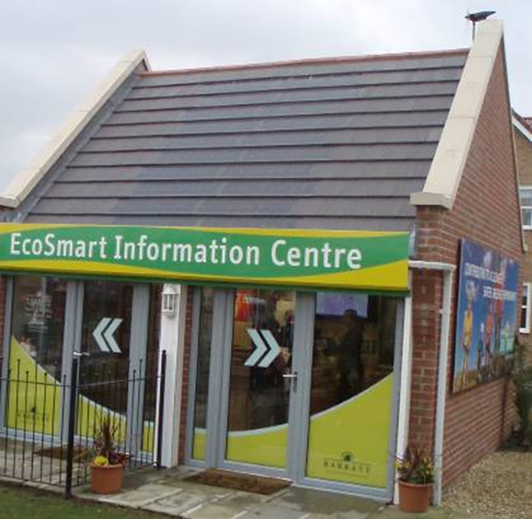
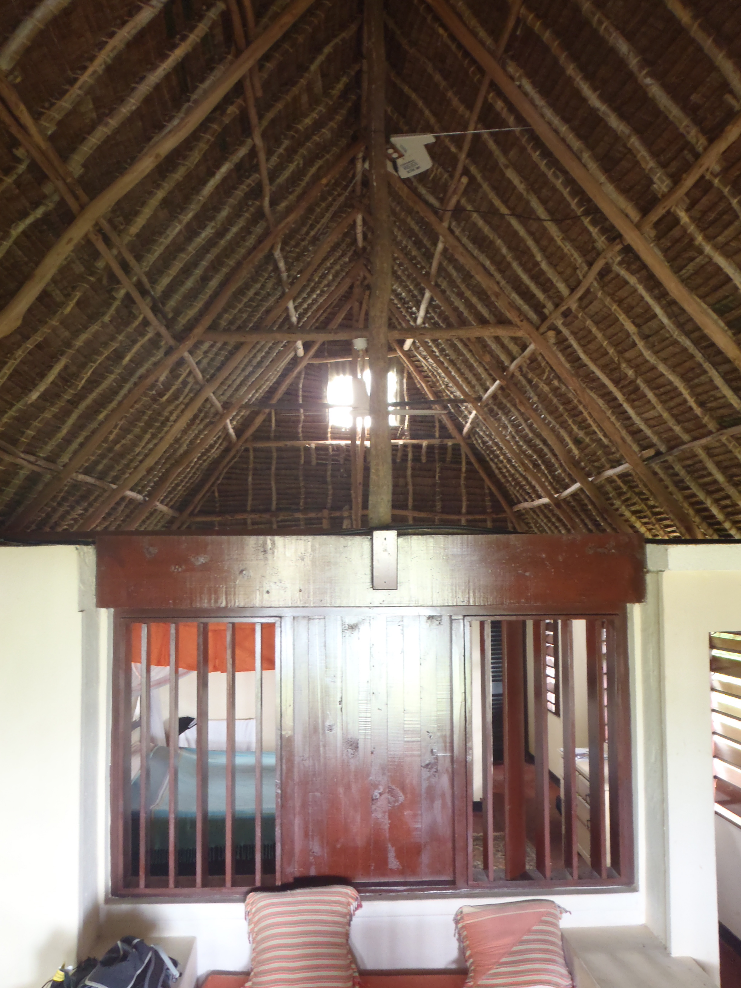
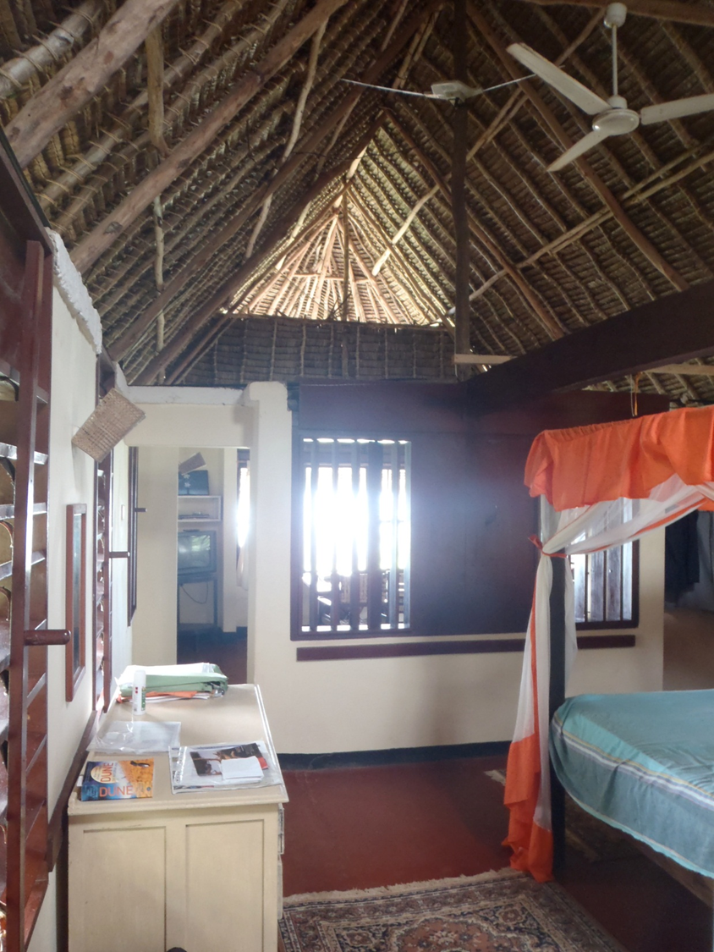
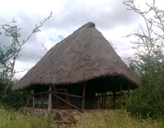
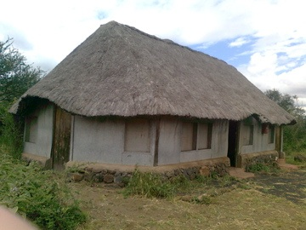
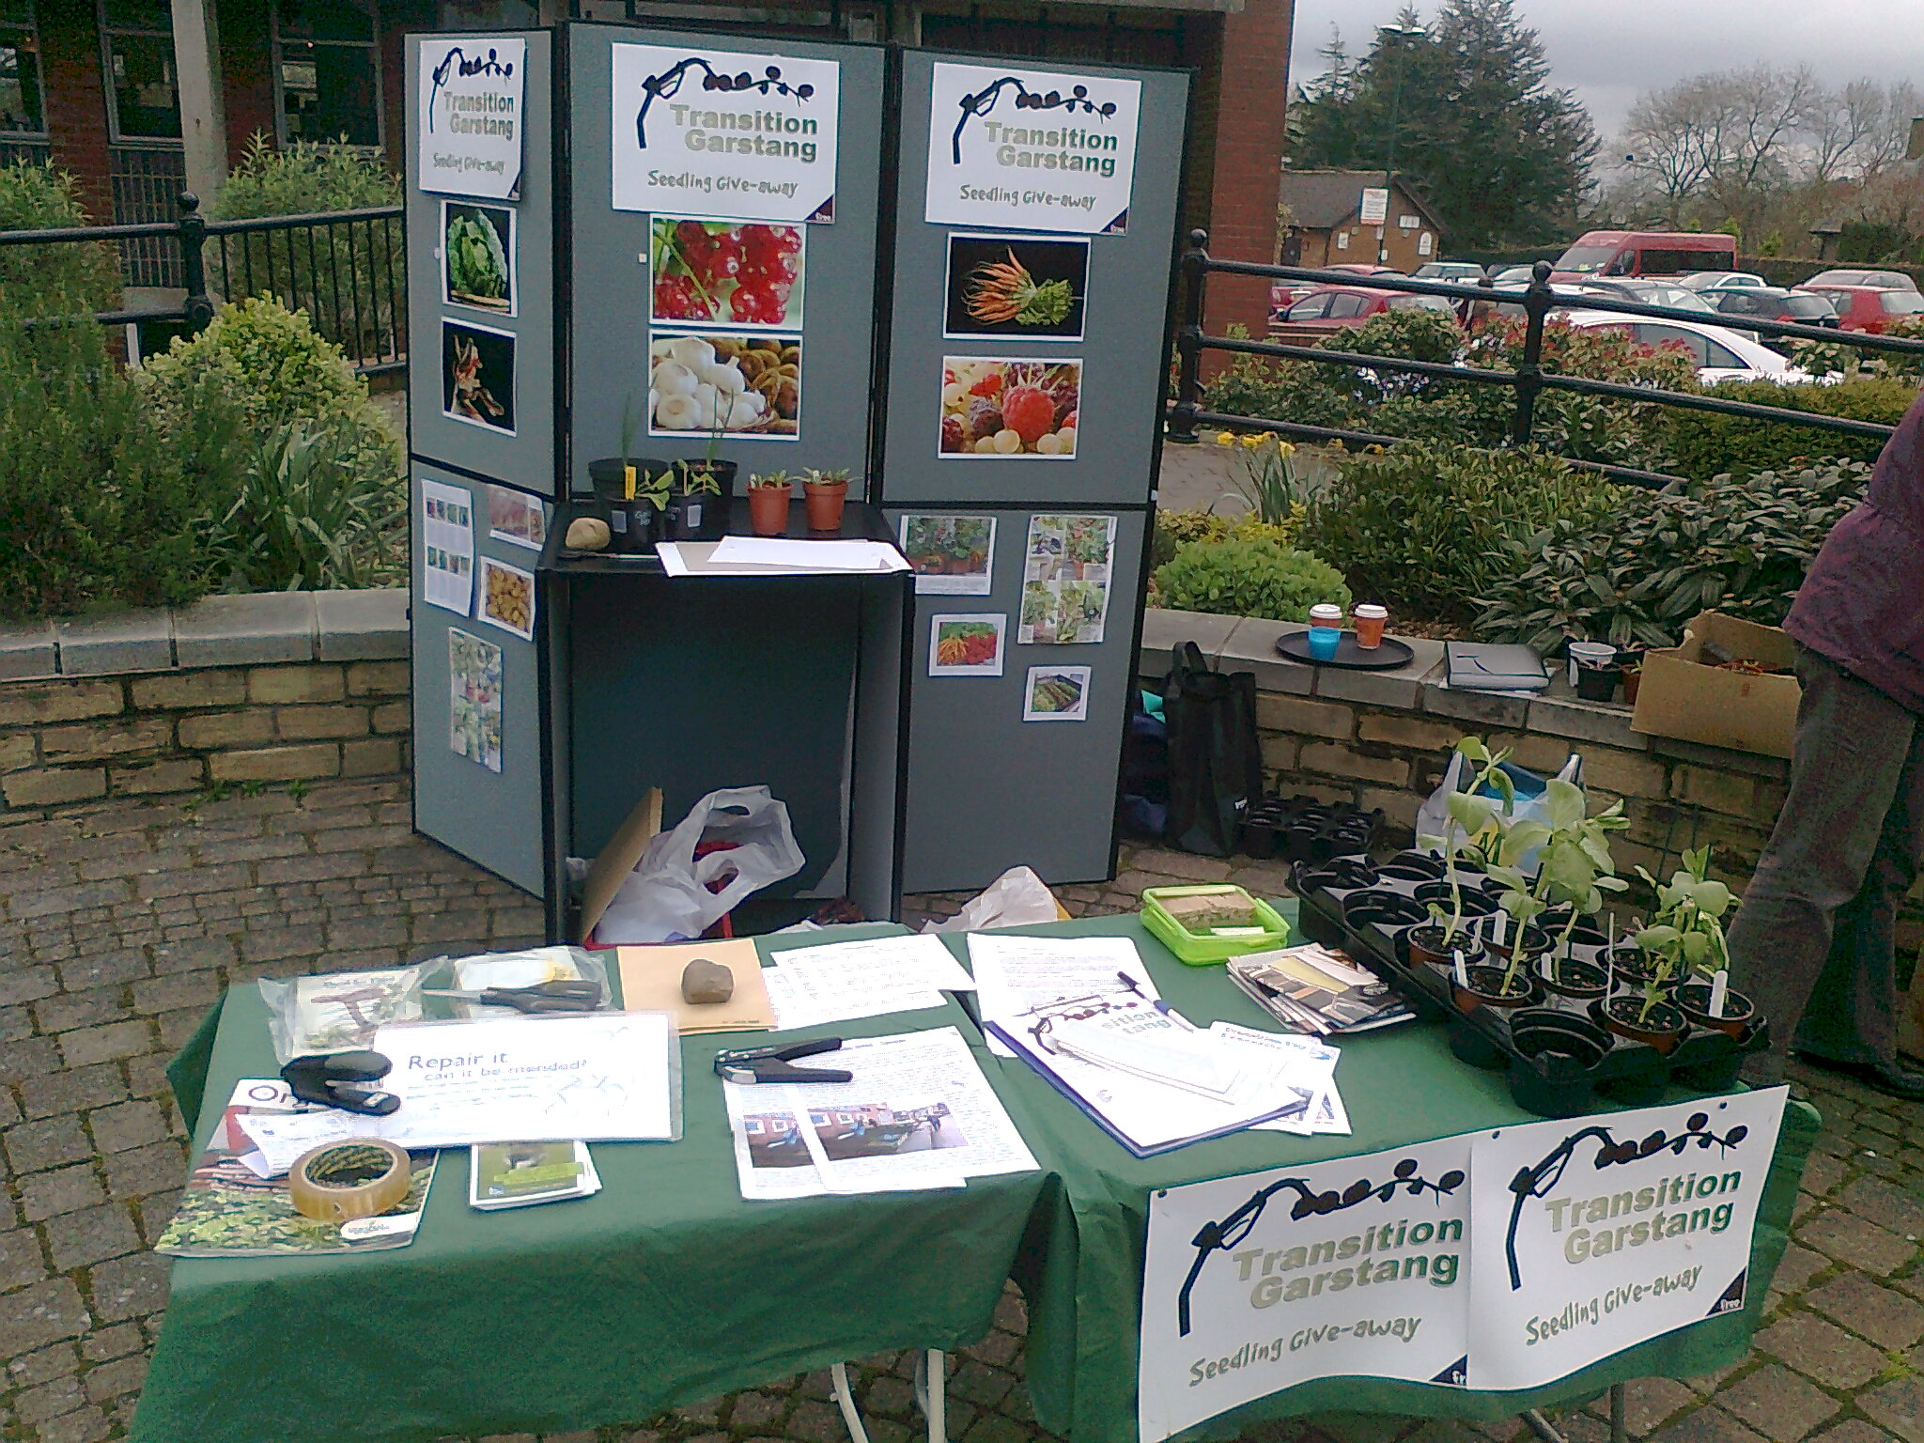
Hi-tech versus Eco-Vernacular architecture for sustainability?
My ecohomes project seeks to
identify barriers to the creation of a more sustainable built environment,
evaluate strategies to overcome these barriers and
test a range of policy options to embed sustainability targets within the full range of regulations, market interventions and plans that apply to both new and refurbished residential property.
It is likely that a mix of market forces (led by energy prices, subsidies and fashion) and Government schemes (especially in the public sector) will, together, have more effect than a few innovative projects. Some of these, such as the last administration’s English ‘Eco Towns’ and Barratts’ Buckshaw ‘EcoSmart’ Village appear to have had little effect, and not yet provided the research outcomes promised.
Regulations to improve new buildings’ energy efficiency seem to have more effect than builders’ competition for ‘green’ credentials, at least at the cheaper end of the market. At the UK’s relatively low rates of new building the performance of existing buildings is crucial. Here the market in retrofitted upgrades for domestic property lags behind what is possible. Planning and the high price of building land favour higher densities, to the extent that some equate ‘compact cities’ with sustainable development. Concepts such as ‘transition towns’ may emphasise local provision, particularly of food, and might favour other forms of individual empowerment. Self-build has long associations with alternative ‘green’ lifestyles and it is possible that current enthusiasms, and a pragmatic DIY culture, might lead to demand for unconventional forms of development. There may be lessons to be learnt from what might be called a new, tourism led, form of eco-vernacular that merges local traditions and materials to meet visitors’ demands and expectations.
While manufacturers’ show homes at BRE Innovaton Park demonstrate what new technologies & products can achieve, emerging forms of Tourist Eco-Vernacular Architecture suggest that local materials combined with traditional design may compete with, and perhaps out perform, more ‘industrial’ options.
Neither fit well with a conservative mainstream that favours ordinary buildings and conventional places.
The challenge is to find acceptable ways to improve building performance. These should go beyond better energy efficiency to reduce other inputs & impacts, & ensure safety in extremes such as earthquakes, landslides, floods & storms.
BRE Innovation Park
‘Chips’ New Islington, Manchester
Buckshaw EcoVillage
Maweni tourist cottage, Kenya
The importance of this in that
Kuku fieldstudy centre, Kenya: tourist eco-vernacular
Most of us occupy buildings that are somewhere between the extremes of corporate delivery of a product designed, manufactured, transported, assembled and run using the latest technologies, and places that we have a part in making, adapting, repairing and using. As we become more wealthy, and our expectations rise, so we may be expected to move further away from a primitive vernacular. But as the rise of the Arts & Crafts movement demonstrated, and a passion for DIY may show, such linear progress is far from certain. Nor is the superiority of the product sold by corporations and regulated by governments. So we need to know what is possible, what is happening and if the public is as wedded to current domestic lifestyles as it appears to be. Only then might its full potential for impact reduction and enhanced performance be realised.
Transition Town stall , Garstang
Michael Clark mclark@uclan.ac.uk
Research 2012

