Slide 1


Themes, Issues, & Practice Dilemmas in Ethnic Matching in Adoption
Dr Julie Ridley
School of Social Work
Diversity Conference, Vancouver, 2012

Slide 2
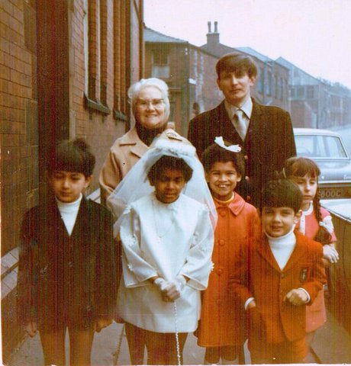

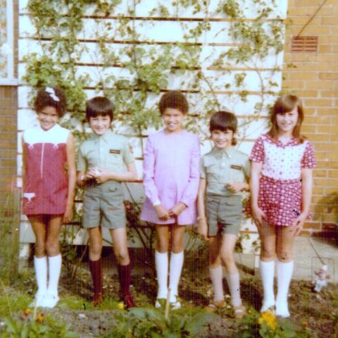
The Team
Dr John Wainwright
Dr Julie Ridley

Slide 3
Some Key Terms
BME (Black and minority ethnic) – individuals and communities of Asian and African/ Caribbean heritage
Black – political term, used interchangeably with BME but does not articulate the diversity
Dual heritage – explains identity and/or relationship comprising two or more ethnicities.

Slide 4
Adoption – permanent placement of a child with adults who assume full parental responsibility
Ethnic matching – refers to the focus on ethnicity as a key factor when placing BME children for adoption
TRA – placement of BME and/or dual heritage child with white adoptive parents

Slide 5
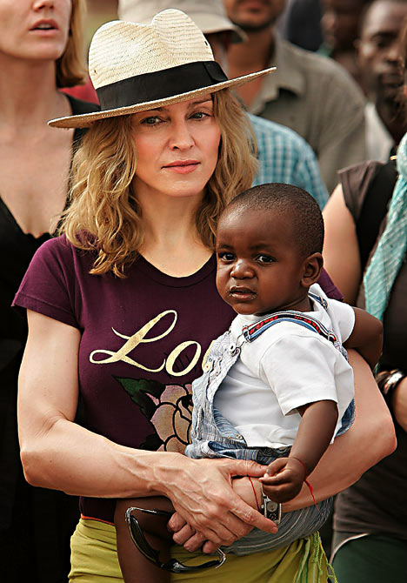
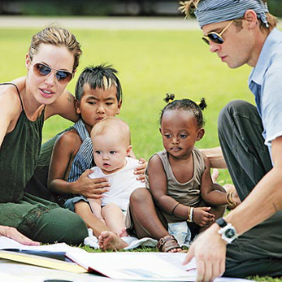
High profile inter-
country adoptions

Slide 6
Political Interest (UK)
“Ethnicity should not be a barrier to adoption if there are loving, stable and secure families ready and waiting to adopt children.” Children’s Minister
‘Thousands of children currently in the care system are waiting to be adopted. Every day they’re denied the loving home all children deserve. But politically correct attitudes and ridiculous bureaucracy keep many of those children waiting for too long. Edicts which say children have to be adopted by families with the same ethnic background and which prevent other families adopting because they don’t fit into left wing prescriptions are denying children the love they need.’
Government Minister, Guardian newspaper 2011

Slide 7
Racialised Power Dynamics
“Transracial placements as an aspect of current child care policy is in essence a microcosm of the oppression of black people in this society . . . It is in essence 'internal colonialism' and a new form of the slave trade, but this time only black children are used” (ABSWAP 1983, Appendix 1 in Gaber and Aldridge 1994).
“On inter-racial adoption, Cameron is wrong. Colour blindness is disability. Fast tracking children to be adopted by white families will only make the needs of black children invisible” (Lemn Sissay, Guardian, 13 March 2012)
Notes:
Polarised views
Ideological?
Identity politics?
How can it be better to leave black children in care?
Ethnicity and ‘race’ are unscientific myths- therefore difference can’t be broken down on basis of colour
Attitudes have changed from 80s – it’s more tolerant now?
Trans-ethnic adoption is about conforming to norms and is colour blind
Racial identity is minor compared to trauma of being in care

Slide 8
Looked After Children (UK)
Black children over-represented – 10% (3% of population)
Takes twice as long for adoption of black children as white children
Process of placing children in adoption up to 2 years – seen as unacceptable

Slide 9
Recruitment of BME Adopters
Soul Kids Campaign (1977)
Importance of ethnically diverse workforce
More culturally sensitive assessment (Barn, 2000)
Eurocentric practices (Small, 1986)
Responsibility shifted from BME communities to agency
Failure to recruit result of institutional racism (Frazer & Selwyn, 2005; Harris, 2006)
Importance of culturally sensitive systems (Sunmonu, 2000)

Slide 10
Evaluation of An Adoption Service
Commissioned by Action for Children
Sept 2009 - June 2010
To assess effectiveness
Motivations and perspectives
To inform planning and practice
Notes:
Research Questions
What strategies are used?
What difference does it make?
Is the service effective?
Are children at the centre?
What are adopters’ and social workers’ motivations?
Implications for future practice?

Slide 11
Evaluation Methodology
Comparative Design
Qualitative
Focus groups
Semi-structured interviews
Quantitative
Statistical information
Matching records (PARs/ Form F, Adoption placement report)
Thematic analysis
Stakeholder Workshop

Slide 12
Evaluation Samples
Adopters
Interviews with 24 individuals (some couples)
Records relating to 16 matches
Statistics on 78 adopters
Staff
Interviewed 18 staff (Social Workers, Admin, Managers)
Local Authority/State
Responses from 30 staff (Social Workers, Managers) to online survey (35% response rate)
Adoption Panel
Observation and group interview with 15 panel members
Children
Records relating to 16 matches
Statistics on 97 + 23 children

Slide 13
Specialist Focus
Both demonstrated political, ideological and professional commitment to ethnically matched adoption placements:
“Black people felt that agencies did not understand what they were about, a fear of being rejected and not wanting to (approach) local authorities because of a potential stigma and a lack of understanding.” (Service Manager)
“Everybody here came to this project because they’ve got a passion to work with black families you know to place black children with black families.” (Project Staff)

Slide 14
Met ethnic & cultural needs of potential adopters
Specialist service endorsed by adopters:
“The fact we had a black social worker I feel that was…
especially when you’ve got to lay your whole life bare and your life experiences for somebody else who is black they will understand…” (Adopter)

Slide 15
Recruitment and Assessment
Similar process for both
Specialists recruited 4 x more BME adopters
Key success factors
Marketing worker, BME staff group – “…brings a lot of added value in terms of understanding and offering support” (Manager, specialist service)
Prompt initial response
Supportive

Slide 16
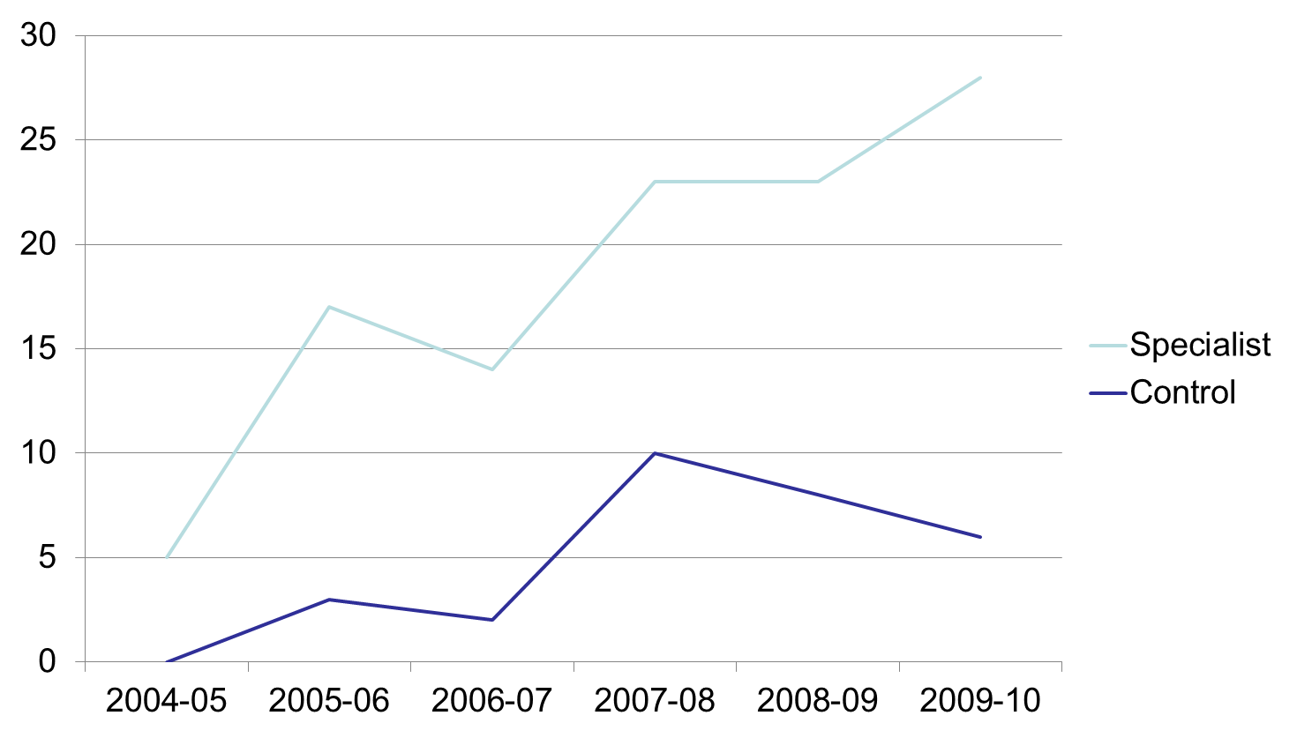
Placements by Specialist & Control Services

Slide 17
Comparison of Adopters
Adoptive families recruited – 78 & 17
Dual heritage relationships - 50% & 65%
Same ethnicity couples - 29% & 17%
Single parents - 21% & 18%

Slide 18
Ethnicity of Adopters

Slide 19
“They literally swept us off our feet and sort of took care of us because it is a really hard phone call to make when you’re phoning up a London Borough and you’re saying you know ‘we’re interested in adoption, what do I do?’ Its down to the other person to tell us what to do and they (ABF) did look after us... and that’s why we stuck with them because we felt from day one they built up that relationship with us and showed us that they actually cared about what they were doing and what we were doing.”
(Adopter)

Slide 20
Ethnicity of Children Placed

Slide 21
Ethnic Matching
Generic adoption criteria (Dance et al, 2010)
Need for physical resemblance
51% ethnic matches were close or good ‘fit’
Two main types:
General based on physical resemblance and broad categories
Specific based on region, culture and religion
Dual heritage - complex, conceptual, practice issues
Importance of flexibility and pragmatism

Slide 22
Examples of Matches
Ethnic fit
Greek child, Greek adopters
Black Caribbean child, black Caribbean adopters
Partial fit
White British/Caribbean child, Spanish/Nigerian & black Caribbean adopters
No ethnic fit
Chinese child, white Irish/Malaysian adopters
White Hungarian/Arabic child, white British/Asian British adopters

Slide 23
“They allow the boundaries to leak much in terms of identities and ethnicities than I know the local authorities. My daughter is black African and I’m not, I’m black Caribbean and I know that would have been a difficulty. She is the right child for me, but that would have been a difficulty because on her form it said her birth mother wants a black African parent. So that automatically would have crossed me out, but I found they actually allowed that fluidity.” (Adopter)

Slide 24
“We don’t have a great pool of Chinese adopters, but saying that I don’t think we’ve seen a lot of profiles of children. . . . At the moment we have a restriction on Asian, or Asian and white, who are of Sikh or Hindu religion, simply because of the limited number of children available. Although we have been able to place some, we have some adopters who have waited a long time, whereas there seems to be a greater number of Pakistani or Muslim religion, so those families are not hard to match.” (Service Manager)

Slide 25
Recommendations/Implications
Specialist focus effective
Importance of staff diversity
Importance of analysing market need
Implications for theory, policy & practice of changing nature of ethnicity
Gaps in research - outcomes for children

Slide 26
References
Barn, R., 2000. ‘Race, Ethnicity and Transracial Adoption’, In A. Treacher and I. Katz, The Dynamics of Adoption: Social and Personal Perspectives. Ch 8. London: Jessica Knightly.
Dance, C.; Ouwejan, D.; Beecham, J. and Farmer, E., 2010. Linking and Matching: A survey of adoption agency practice in England and Wales. London: BAAF.
Frazer, L and Selwyn, J., 2005. ‘Why are we waiting? The demography of adoption for children of black, Asian and black mixed parentage in England.’ Child and Family Social Work, Vol 10, pp.135-147.
Gaber, I. and Aldridge, J., eds. 1994. In the best interests of the child: Culture, Identity and Transracial Adoption. London: Free Association Books.
Harris, P., 2006, ed. In Search of Belonging: Reflections by Transracially Adopted People. London: BAAF.
Small, J., 1986. ‘Transracial Placements: conflicts and contradictions’. In S. Ahmed,J. Cheetham, and J. Small, 1986. Social Work and Black Children and their Families. London: Batsford/BAAF.
Sunmonu, Y., 2000. Why Black Carers are deterred from Adoption. Adoption and Fostering. Vol 24, No1, pp. 59-60.

Slide 27
Evaluation Report
Ridley, J., Wainwright, J., with Davda, P. (2010),
‘Black’ families for ‘black’ children? An evaluation of Action for Children’s practice in ethnically matching black, Asian and dual heritage children for adoption. Preston: University of Central Lancashire Print Shop.
Contact: Dr Julie Ridley
Email: JRidley1@uclan.ac.uk
Telephone: +441772 893402

